Slide 1
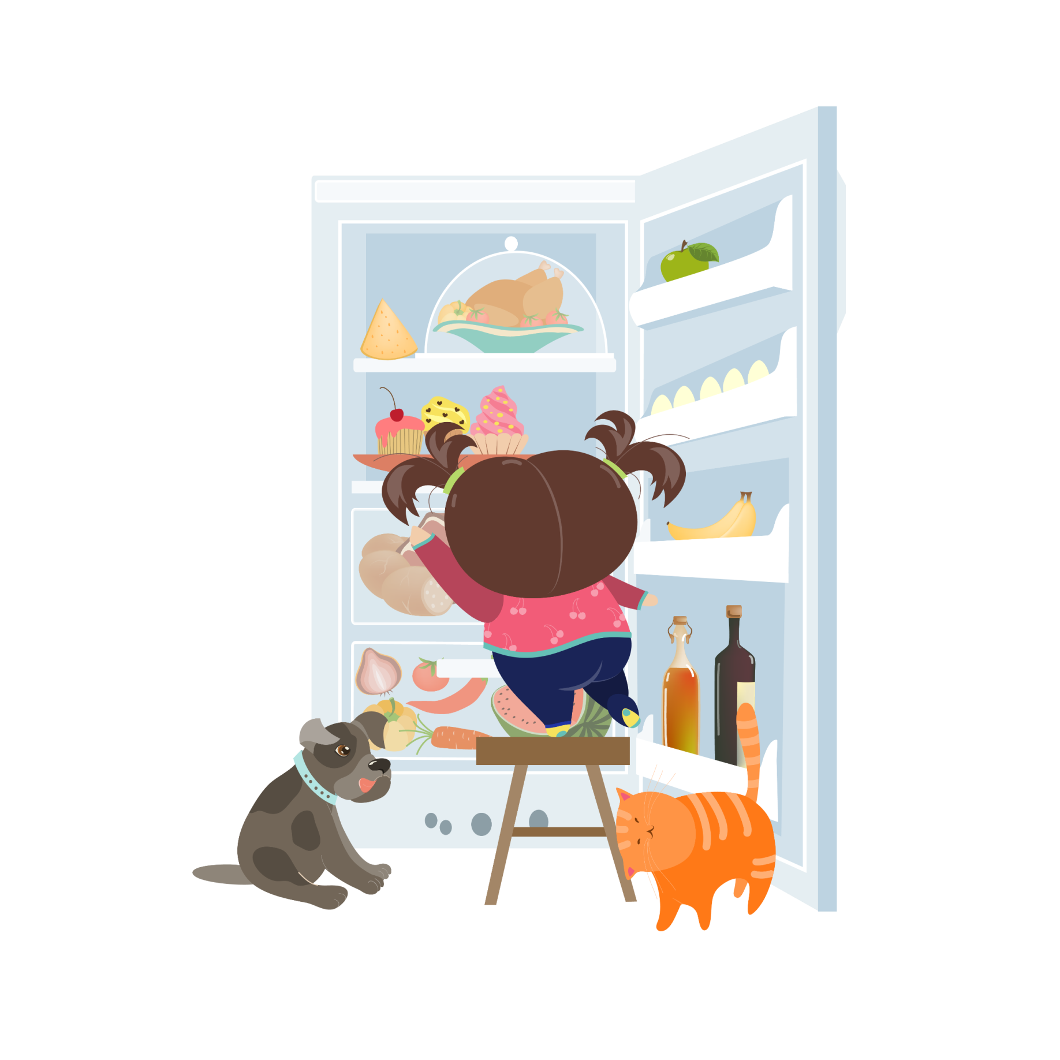
手绘小清新总结通用模板
THIS IS A ART TEMPLATE , THANK YOU WATCHING THIS ONE. THIS IS A ART TEMPLATE , THANK YOU WATCHING THIS ONE.

Slide 2
YOUR TITTLE
1
Just for today I will try to live through this day only and not tackle my whole life at once.
YOUR TITTLE
2
CONTENT
Just for today I will try to live through this day only and not tackle my whole life at once.
YOUR TITTLE
3
Just for today I will try to live through this day only and not tackle my whole life at once.
YOUR TITTLE
4
Just for today I will try to live through this day only and not tackle my whole life at once.

Slide 3
01
ADD YOUR TITTLE HERE
Just for today I will try to live through this day only and not tackle my whole life at once.

Slide 4
ADD YOUR TITTLE HERE
Just for today I will try to live through this day only and not tackle my whole life problem at once Just for today I will try to live through this day only and not tackle my whole life problem at once Just for only and not tackle my whole life problem at once Just for today I will try to live through this day only and not tackle my whole life problem at once Just for

Slide 5
ADD YOUR TITTLE HERE
THIS IS A ART TEMPLATE ,THANK YOU WATCHING THIS ONE
ADD YOUR TITTLE HERE
ADD YOUR TITTLE HERE
Just for today I will try to live through this day only and not tackle my whole life problem at once. I can do for twelve hours that
Just for today I will try to live through this day only and not tackle my whole life problem at once. I can do for twelve hours that
ADD YOUR TITTLE HERE
ADD YOUR TITTLE HERE
Just for today I will try to live through this day only and not tackle my whole life problem at once. I can do for twelve hours that
Just for today I will try to live through this day only and not tackle my whole life problem at once. I can do for twelve hours that

Slide 6
12，000
10，000
20，000
TITTLE HERE
TITTLE HERE
TITTLE HERE
Just for today I will try to live through this day only and not tackle my whole life problem at once. I can do
Just for today I will try to live through this day only and not tackle my whole life problem at once. I can do
Just for today I will try to live through this day only and not tackle my whole life problem at once. I can do

Slide 7
ADD YOUR TITTLE HERE
Just for today I will try to live through this day only and not tackle my whole life problem at once Just for today I will try to live. through this day only and not tackle my whole life problem at once Just for today I will try to live. through this day only and not tackle my whole life problem at once Just for today I will try to live. through this day only and not

Slide 8
02
ADD YOUR TITTLE HERE
Just for today I will try to live through this day only and not tackle my whole life at once.

Slide 9
0 1
Just for today I will try to live through this day only and not tackle my whole life problem at once Just for today I will try to live through this day only and not tackle my whole life problem at once Just for only
0 2
Just for today I will try to live through this day only and not tackle my whole life problem at once Just for today I will try to live through this day only and not tackle my whole life problem at once Just for only
0 3
Just for today I will try to live through this day only and not tackle my whole life problem at once Just for today I will try to live through this day only and not tackle my whole life problem at once Just for only
0 4
Just for today I will try to live through this day only and not tackle my whole life problem at once Just for today I will try to live through this day only and not tackle my whole life problem at once Just for only

Slide 10
01
①
②
02
hours that Just for today I will try to live through this day only and not tackle my whole life problem at once.
hours that Just for today I will try to live through this day only and not tackle my whole life problem at once.
18%
55%
12%
04


03
15%
hours that Just for today I will try to live through this day only and not tackle my whole life problem at once.
hours that Just for today I will try to live through this day only and not tackle my whole life problem at once.

Slide 11
03
ADD YOUR TITTLE HERE
Just for today I will try to live through this day only and not tackle my whole life at once.

Slide 12
Creativity
Maps
Help
Tools
Just for today I will try to live through this day only and not tackle my whole
Just for today I will try to live through this day only and not tackle my whole
Just for today I will try to live through this day only and not tackle my whole
Just for today I will try to live through this day only and not tackle my whole

Slide 13
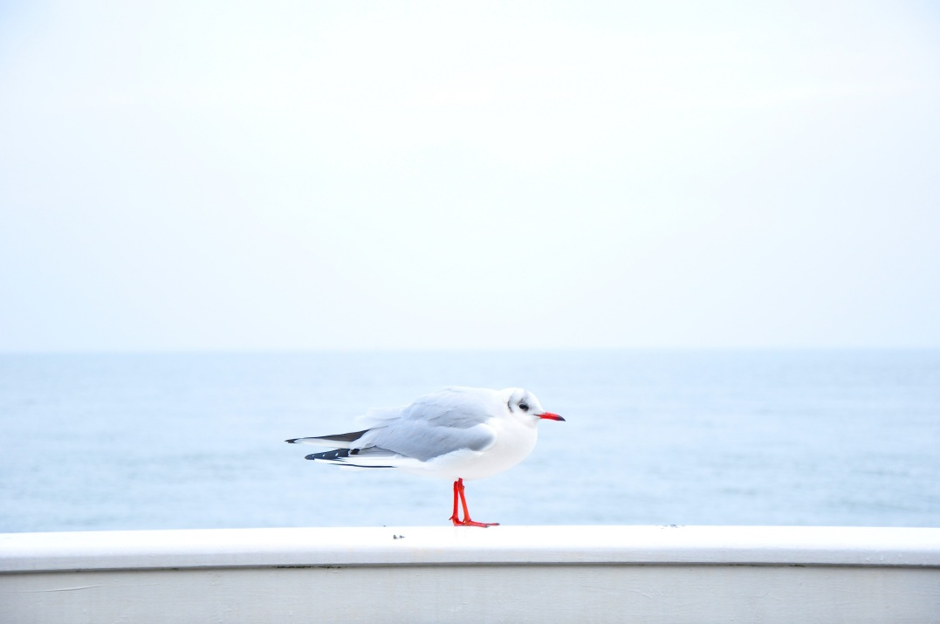
Just for today I will try to live through this day only and not tackle my whole life problem at once. I can do for twelve this day only and not tackle my whole life problem at once. I can do for twelve hours that

Slide 14
04
ADD YOUR TITTLE HERE
Just for today I will try to live through this day only and not tackle my whole life at once.

Slide 15
01
YOUR TITTLE
Just for today I will try to live through this day only and not tackle my whole life at once.
YOUR TITTLE
02
ADD YOUR TITTLE HERE
Just for today I will try to live through this day only and not tackle my whole life at once.
Just for today I will try to live through this day only and not tackle my whole life problem at once. I can do for twelve hours that
YOUR TITTLE
03
Just for today I will try to live through this day only and not tackle my whole life at once.
YOUR TITTLE
04
Just for today I will try to live through this day only and not tackle my whole life at once.

Slide 16
感谢大家的观看
THIS IS A ART TEMPLATE , THANK YOU WATCHING THIS ONE. THIS IS A ART TEMPLATE , THANK YOU WATCHING THIS ONE.

Slide 17
10000+套精品PPT模板全部免费下载
PPT营
www.pptying.com
Notes:
模板来自于 https://www.pptying.com 【PPT营】

