Slide 1



101
CONTENT
MARKETING
How To Make Your Content Marketing
Strategy Better.
© 1999 - 2014 IX Web Hosting. All rights reserved

Slide 2



1 What Is Content Marketing?
2 Why Is It important?
3 Most Shared Content Types
4 How To Make Your Content Strategy Better!
5 Conclusion
© 1999 - 2014 IX Web Hosting. All rights reserved

Slide 3


What Is Content Marketing?
It involves creation (and distribution) of informative and engaging content that aims at increasing customer loyalty as well as business prospects.
A few of the tactics of content marketing include:
» Blogging
» E-Books
» Webinar
» Press Release
© 1999 - 2014 IX Web Hosting. All rights reserved

Slide 4
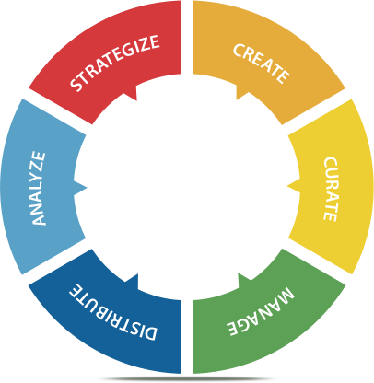



© 1999 - 2014 IX Web Hosting. All rights reserved

Slide 5

And It Is Important..
..because in a world where we have access to unlimited information in a matter of seconds, information based marketing has become vital.
© 1999 - 2014 IX Web Hosting. All rights reserved

Slide 6
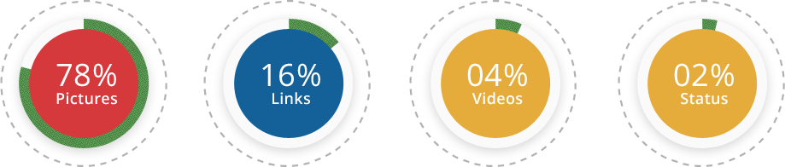
With The Most Shared Content Being..
© 1999 - 2014 IX Web Hosting. All rights reserved

Slide 7
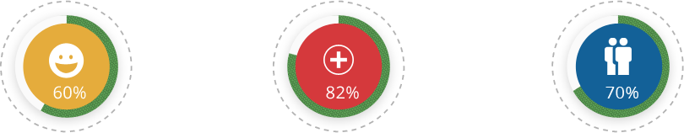
Here’s Something Good To Know!
60% of consumers enjoy reading relevant content from brands.
82% of consumers feel more positive about a company after reading custom content.
70% of consumers feel closer to a company as a result of content marketing.
© 1999 - 2014 IX Web Hosting. All rights reserved

Slide 8


© 1999 - 2014 IX Web Hosting. All rights reserved

Slide 9



Sign Up With A Web Host!
The first and the foremost thing to do is to sign up for services. When your content gets shared, people click through and get redirected to your website, and your website needs to be running efficiently.
Remember: First impression is the last impression.
webhosting
© 1999 - 2014 IX Web Hosting. All rights reserved

Slide 10
Why Choose IX Web Hosting?
Affordability
Cutting edge technology at reasonable prices. touch to your business.
Scalability
Ability to flex hosting plans in sync with the increasing needs of the website.
Reliability
The 24/7 technical support is prompt and never lets your website down.
Security
Certified by the likes of McAfee, IX servers provide the most secure environment for hosting your web logs.
© 1999 - 2014 IX Web Hosting. All rights reserved

Slide 11

Gather Topics!
Before you start creating your content plan and strategy, it’s always better to research and shortlist a handful of topics that are not just relevant to your business, but also trending in your circles.
Talking about “what’s in” helps you keep your audience hooked.
© 1999 - 2014 IX Web Hosting. All rights reserved

Slide 12
Why Choose IX Web Hosting?
Don’t always go for an all season look, get a makeover based on climate, festivities, etc; it gives a human touch to your business.
A human business is more relatable than one that sounds also robotic and only sales oriented.
If overhauling the website every time isn’t a feasible option; opt for changing the looks of your social profiles.
For example, bring some variation in your cover pictures on Facebook if you feel like keeping the profile picture constant to your business logo.
© 1999 - 2014 IX Web Hosting. All rights reserved

Slide 13

Indulge In Chit Chat Sessions!
Conversations are the best way to keep someone engaged. Try and frame content that not just makes the reader feel you want to talk, but also nudges them to make an interaction.
© 1999 - 2014 IX Web Hosting. All rights reserved

Slide 14


Become Click Happy!
No one has the time to go through text heavy posts; but who doesn’t like bright images? Stock up on a lot of images that are unique to your business and fit them in your content strategy.
They are the most shared post type across online platforms.
© 1999 - 2014 IX Web Hosting. All rights reserved

Slide 15

Share Values!
Do you have a customer or employee friendly policy in place? If yes, share it with your followers and let them know you care! Sharing values helps in bonding with your customers.
© 1999 - 2014 IX Web Hosting. All rights reserved

Slide 16

Work Together!
If not literally, at least to some extent! Try and get real time reviews on your products/services. Ask questions about what your customers expect next and try to fit some of those suggestions into your work. This helps establish a rapport and shows you off as being customer driven. After all, this is exactly what people look for - to be heard!
© 1999 - 2014 IX Web Hosting. All rights reserved

Slide 17

Tell Your Story!
People want to know the thought process behind your business and how it came about to be. Share your story and your unique experiences along the way. It makes your business more relatable.
© 1999 - 2014 IX Web Hosting. All rights reserved

Slide 18
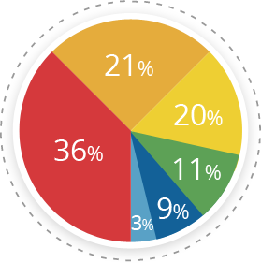
But Here’s The Challenge..
Producing Engaging Content...........36%
Producing Enough Content..............21%
Budget to Produce Content.............20%
Lack of C-Level Buy-In.......................11%
Producing a Variety of Content..........9%
No Answer............................................3%
© 1999 - 2014 IX Web Hosting. All rights reserved

Slide 19



More than 50% of your traffic comes from social media platforms. So how do you go about executing a content strategy AND keep track of what’s trending?
Here are a few tools to make the going easy…
© 1999 - 2014 IX Web Hosting. All rights reserved

Slide 20

Sprout Social
Its a social media tool that not just focuses on presenting you with what’s trending in your circles, but also helps you with CRM.
It offers you insights on the popularity of your business as well as the amount of interaction your business has indulged in. is by far the most popular tool in the market.
Sprout Social
© 1999 - 2014 IX Web Hosting. All rights reserved

Slide 21
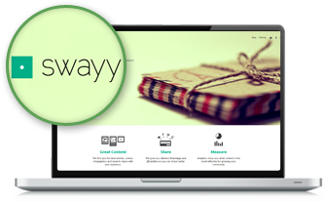
Swayy
Its a tool that analyzes your social community, matches the most relevant content from around the web and offers it on your dashboard,
helps you build a relationship between your content and your followers.
Swayy
© 1999 - 2014 IX Web Hosting. All rights reserved

Slide 22
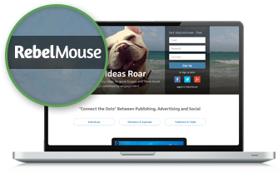
RebelMouse
Claimed as the front page of social media,
helps you curate content for all your online profiles on a single dashboard based on what your business is known for and what conversations your audience has been engaging in.
RebelMouse
© 1999 - 2014 IX Web Hosting. All rights reserved

Slide 23

Social Mention
is a tool capable of scanning the web and producing statistics based on real time buzz around a business. It provides insights on who is talking about your keyword and how often people are engaging in conversations related to you.
Social Mention
© 1999 - 2014 IX Web Hosting. All rights reserved

Slide 24

Conclusion
Content marketing is the new black and if you can carry it off well, it is bound to up your sales graph drastically! So equip yourself with the right tools and start framing your content strategy.
Final Tip:
Don’t sound too pushy, but make sure you sound engaging enough.
© 1999 - 2014 IX Web Hosting. All rights reserved

