Slide 1


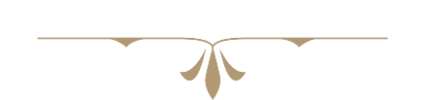
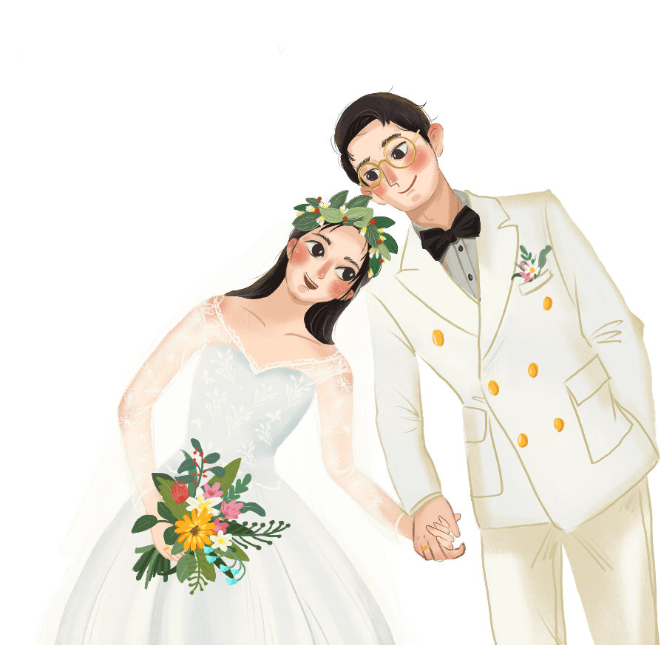



We're married
我
们
结
啦
婚
婚礼电子相册展示
新郎：帅哥
新娘：美丽
20XX.09.12

Slide 2
目录
https://www.ypppt.com/
相识到相恋
相爱到相伴
We met and fell in love
We accompany each other
相恋到相爱
相伴到相依
We‘re in love
We rely on each other

Slide 3


We met and fell in love
相识到相恋

Slide 4

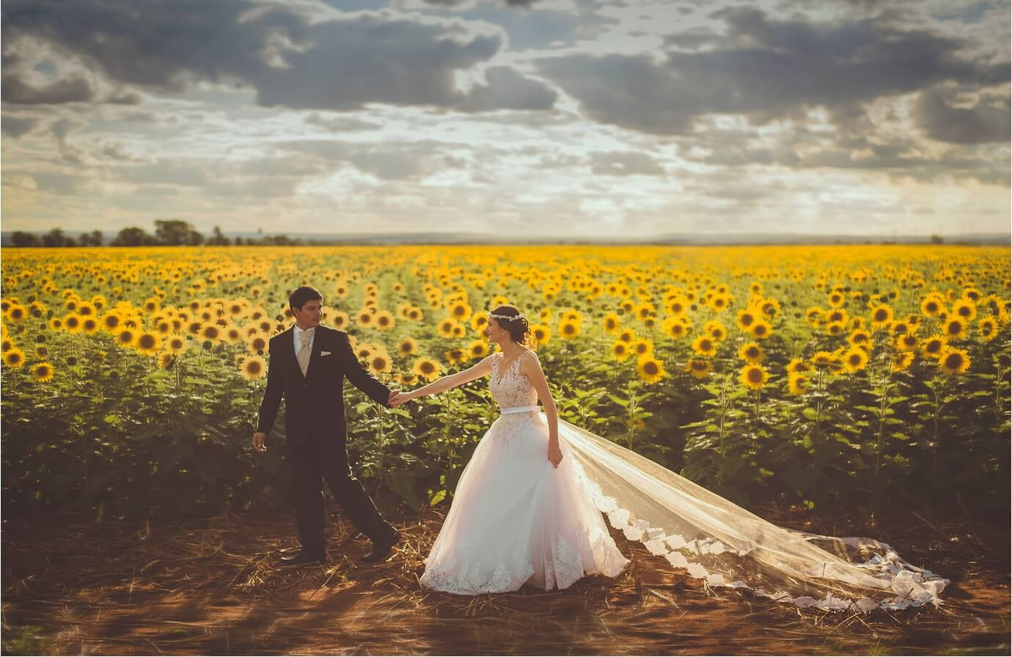


爱情如果是一本童话，我们应该在第一页就相遇了。
If love is a fairy tale, We should have met on the first page.

Slide 5
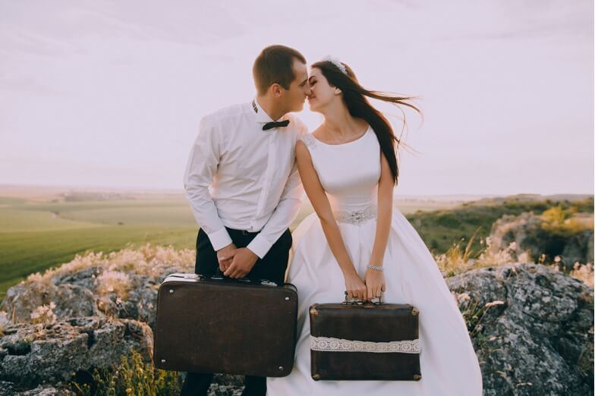
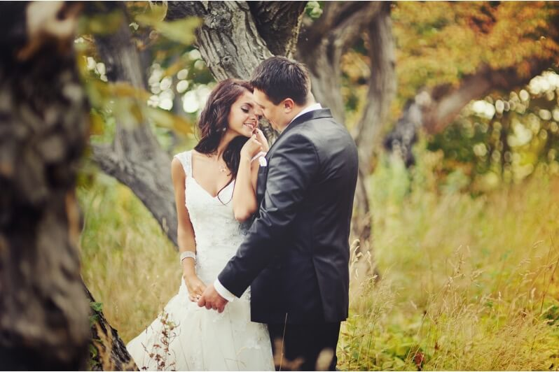
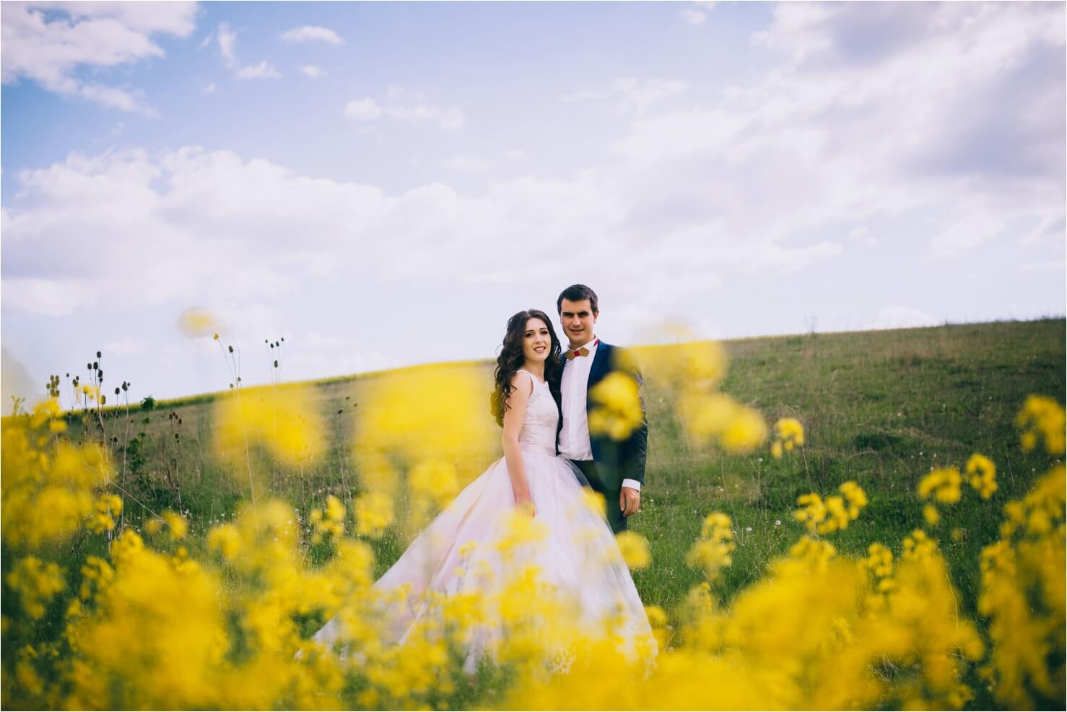
不要问我眼里有没有你，我余光中都是你
Don't ask me if I see you in my eyes, I'm all you in the afterglow

Slide 6

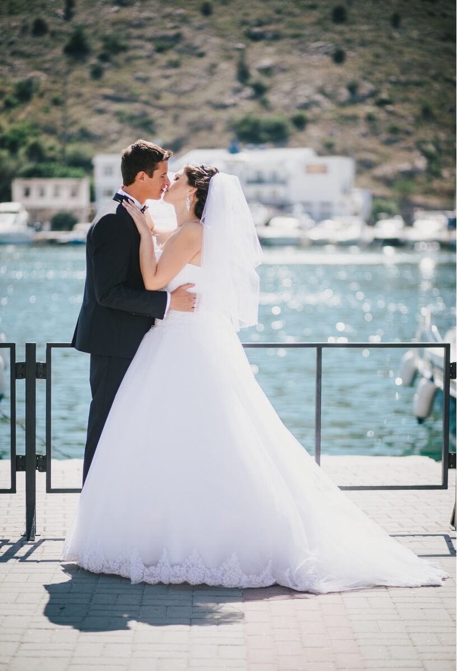
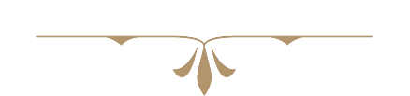
“你最可爱”，我说时来不及思索，而思索之后，还是这样说。
"You are the cutest", I said without thinking, and after thinking about it, I still said so.

Slide 7
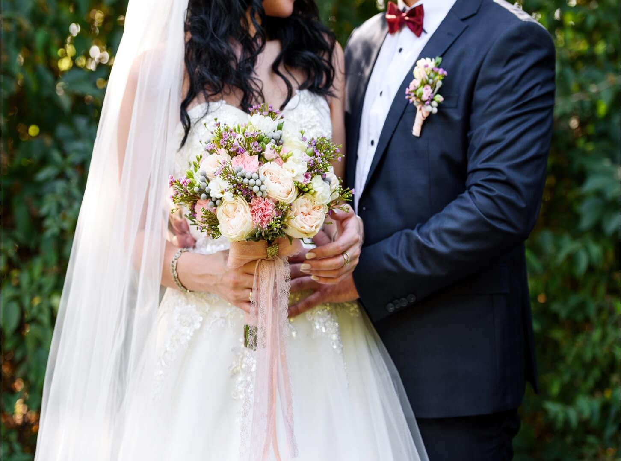


人们从诗人的句子里，
选取自己心爱的意义，
但诗句的最终意义是指向你。
From the poet's sentences,
Choose the meaning you love,
But the ultimate meaning of the poem is to point to you.

Slide 8
We‘re in love
相恋到相爱

Slide 9


“即许一人以偏爱
愿尽余生以慷慨”
"That is, to allow one person to favor May I spend the rest of my life with generosity."

Slide 10

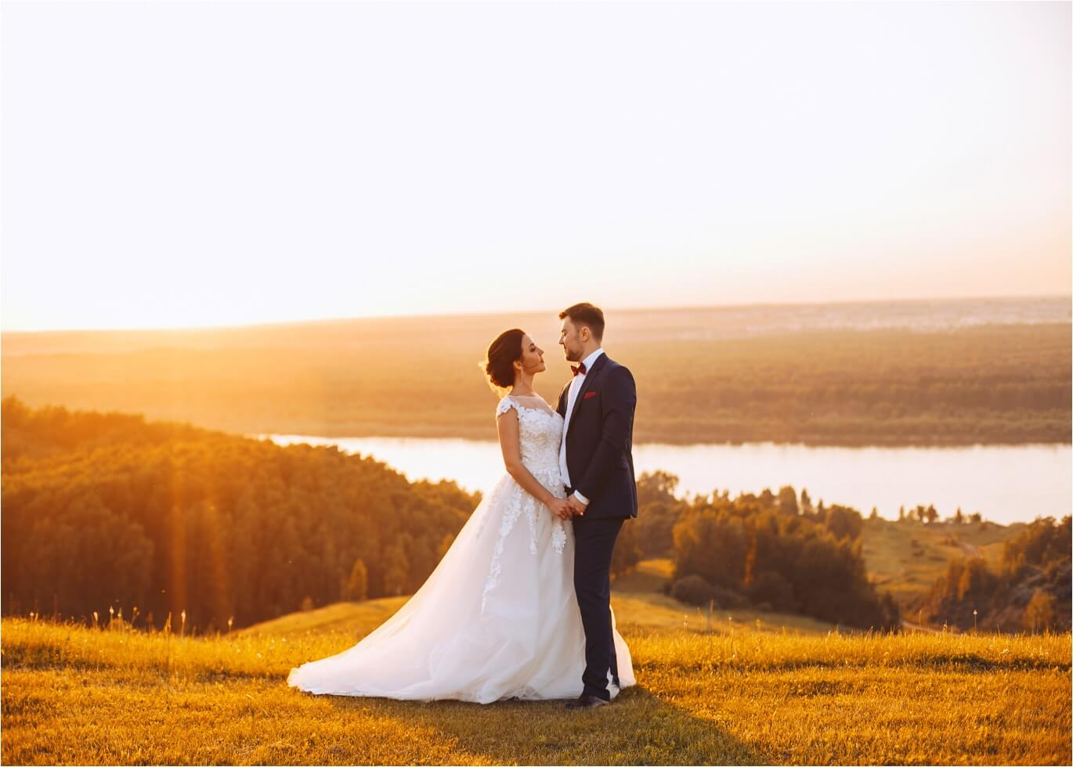
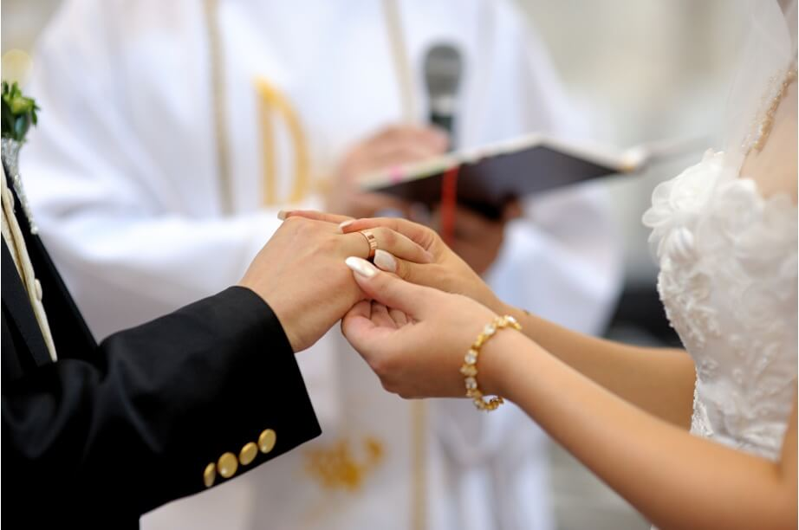

一辈子很短，
如白驹过隙，转瞬即逝，
可是这种心情很长，
如高山大川，绵延不断。
A lifetime is very short, like a white colt passing through the gap, fleeting,
But this mood is very long,
Like the high mountains and rivers, it stretches continuously
节日PPT模板 http://www.ypppt.com/jieri/

Slide 11





我想和你相互浪漫
一起虚度短的沉默
长的无意义
一起消磨精致而苍老的宇宙
I want to be romantic with you
Together with a short silence of emptiness
Long meaningless
Spend time together in a delicate and aging universe

Slide 12
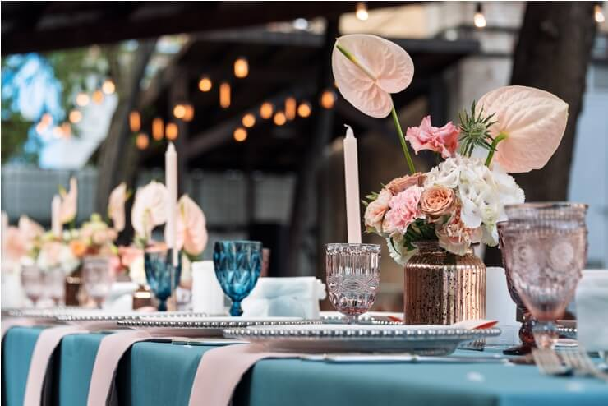
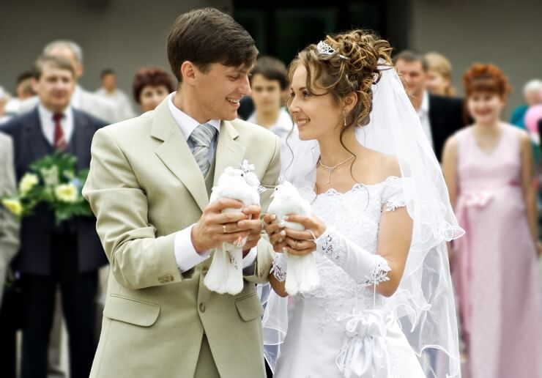
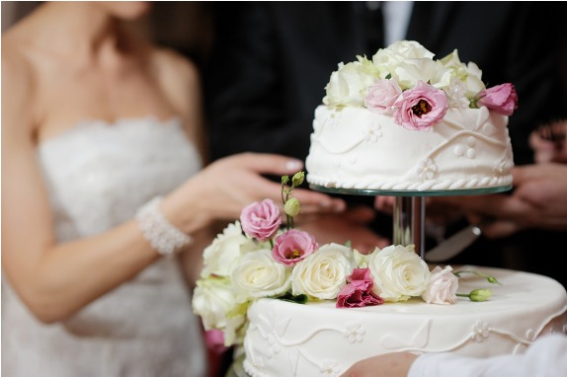
晚霞与玫瑰共绘浪漫
你时我藏在心底的
爱意泛滥
Sunset and rose paint romance together You are hidden in my heart
Love overflows
Notes:
https://www.ypppt.com/

Slide 13
We accompany each other
相爱到相伴

Slide 14



我爱你，不是情话是心里话
I love you Not a love story
It's the heart's word

Slide 15
我想和你相互浪漫
一起虚度短的沉默
长的无意义
一起消磨精致而苍老的宇宙
I want to be romantic with you
Together with a short silence of emptiness
Long meaningless
Spend time together in a delicate and aging universe

Slide 16

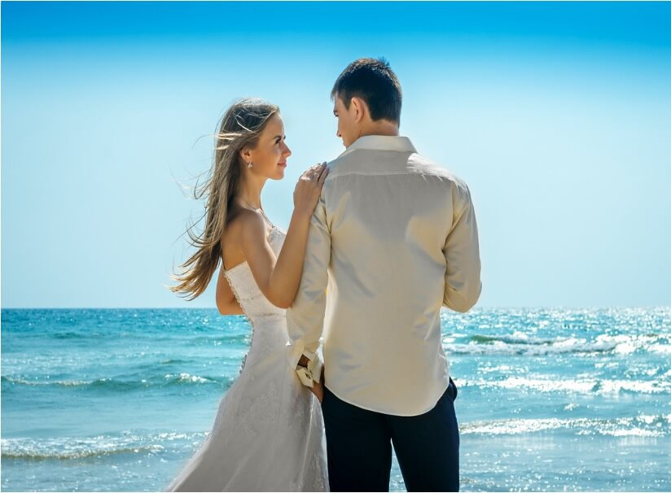

“你最可爱”，
我说时来不及思索，
而思索之后，
还是这样说。
"You are the cutest",
I said without thinking,
and after thinking about it,
I still said so.

Slide 17



不要问我眼里有没有你，我余光中都是你
Don't ask me if I see you in my eyes, I'm all you in the afterglow

Slide 18

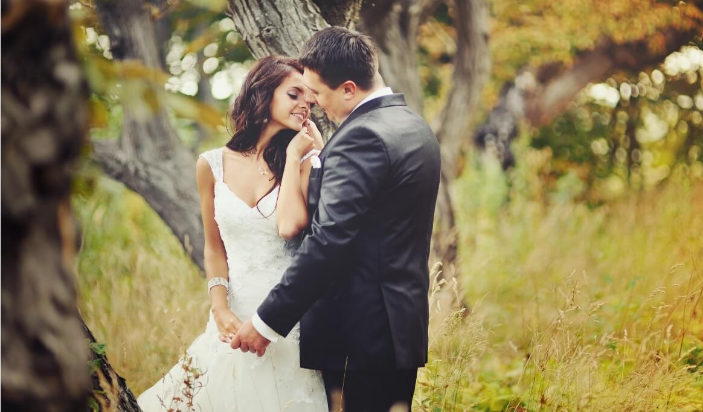
人们从诗人的句子里，
选取自己心爱的意义，
但诗句的最终意义
是指向你。
From the poet's sentences,
Choose the meaning you love,
But the ultimate meaning of the poem is
to point to you.

Slide 19
We rely on each other
相伴到相依

Slide 20


一辈子很短，
如白驹过隙，转瞬即逝，
可是这种心情很长，
如高山大川，绵延不断。
A lifetime is very short,
like a white colt passing through the gap,
fleeting,
But this mood is very long,
Like the high mountains and rivers,
it stretches continuously

Slide 21

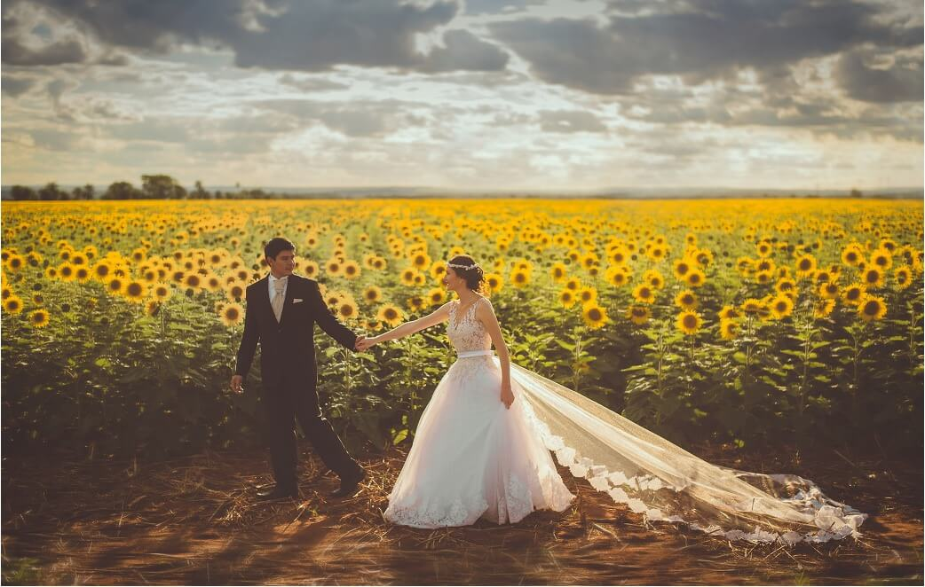
“即许一人以偏爱
愿尽余生以慷慨”
"That is, to allow one person to favor
May I spend the rest of my life with generosity."
We're married

Slide 22


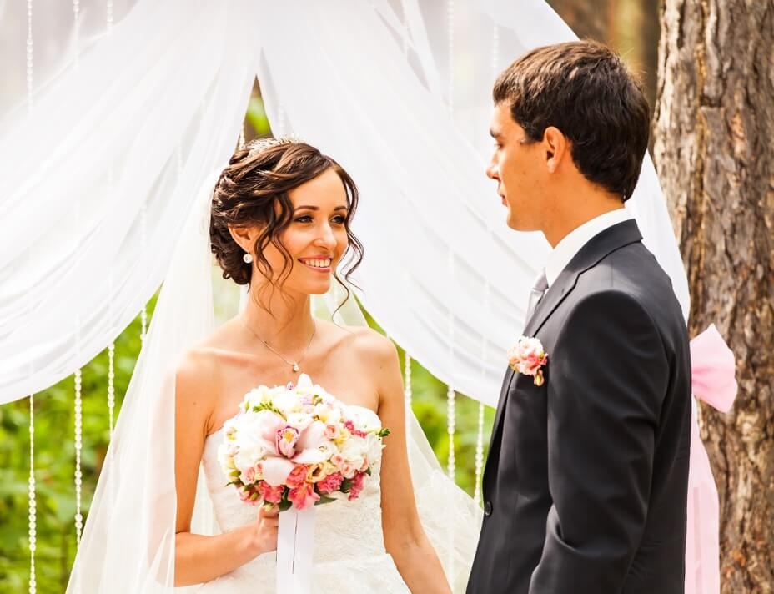


爱情，
是世界上最细小的词，
只能落在一个人身上
Love，
is the smallest word in the world,
It can only fall on one person
我爱你，
不是情话是心里话
I love you，Not a love story
It's the heart's word

Slide 23

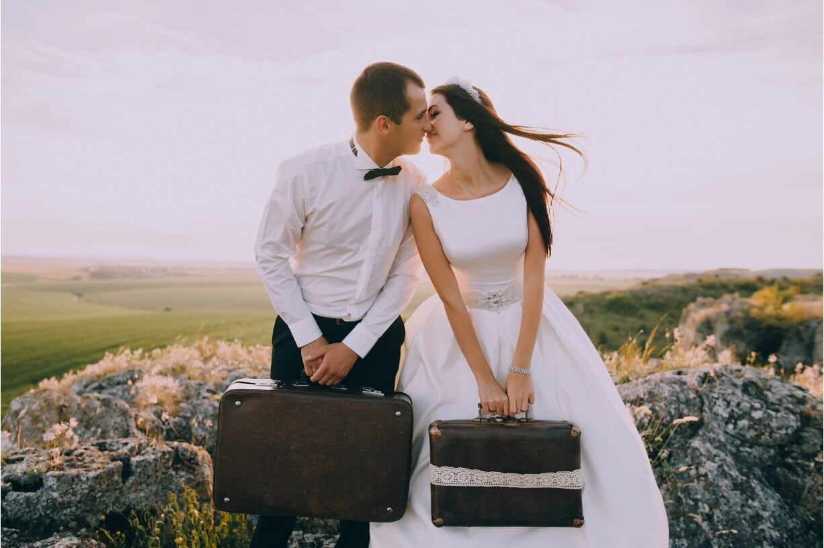

我这一生故事里
有风、有雨、有三餐四季
还有爱你
In the story of my life T
here is wind, there is rain,
there are three meals and four seasons
And love you

Slide 24


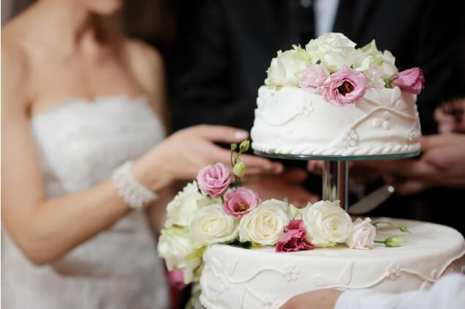
你不在时
白天和黑夜
是分秒不差二十四小时
你在时
有时少些有时多些

Slide 25


We're married
欢迎您的到来
新郎：帅气
新娘：美丽
2029.09.12

Slide 26
更多精品PPT资源尽在—优品PPT！
www.ypppt.com
PPT模板下载：www.ypppt.com/moban/ 节日PPT模板：www.ypppt.com/jieri/
PPT背景图片：www.ypppt.com/beijing/ PPT图表下载：www.ypppt.com/tubiao/
PPT素材下载： www.ypppt.com/sucai/ PPT教程下载：www.ypppt.com/jiaocheng/
字体下载：www.ypppt.com/ziti/ 绘本故事PPT：www.ypppt.com/gushi/
PPT课件：www.ypppt.com/kejian/
Notes:
模板来自于 优品PPT https://www.ypppt.com/

