Slide 1
…………
开
学
第
一
课
{新学期|新气象|教学课件|主题班会}
……
汇报教师：PPTying
………

Slide 2
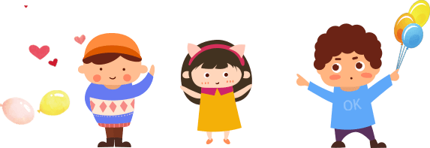
https://www.ypppt.com/
…………
重要课程
学期计划
ONE
TWO
Please allow me to small proud, because like you depend on.
Please allow me to small proud, because like you depend on.
……
班级活动
注意事项
………
THREE
FOUR
Please allow me to small proud, because like you depend on.
Please allow me to small proud, because like you depend on.

Slide 3
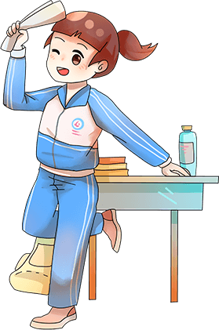
…………
ONE
学期计划
Please allow me to small proud, because like you depend on.
……
………

Slide 4
ONE 学期计划
…………
添加此处标题
请在此处添加具体内容，文字尽量言简意赅，简单说明即可。
We are all too young, a lot of things don't yet know, don't put the wrong loves when gardeners.
……
………

Slide 5
ONE 学期计划
…………
标题文本预设
We are all too young, a lot of things don't yet know, don't put the wrong loves when gardeners.
小标题
小标题
小标题
……
Please allow me to small proud.
Please allow me to small proud.
Please allow me to small proud.
………
01
02
03

Slide 6
ONE 学期计划
…………
小标题
小标题
小标题
标题文本
标题文本
……
………
标题文本
We are all too young, a lot of things don't yet know.
We are all too young, a lot of things don't yet know.
We are all too young, a lot of things don't yet know.

Slide 7
ONE 学期计划
…………
添加此处标题
请在此处添加具体内容，
文字尽量言简意赅，简单说明。
……
………
We are all too young, a lot of things don’t
yet know, don't put the wrong loves when gardeners.

Slide 8
…………
TWO
重要课程
Please allow me to small proud, because like you depend on.
……
………

Slide 9
TWO 重要课程
…………
……
标题文本预设
………
We are all too young, a lot of things don't yet know, don't put the wrong loves when gardeners. The life most of the time, commitments equals to constrain, reluctantly we yearn for bound.

Slide 10
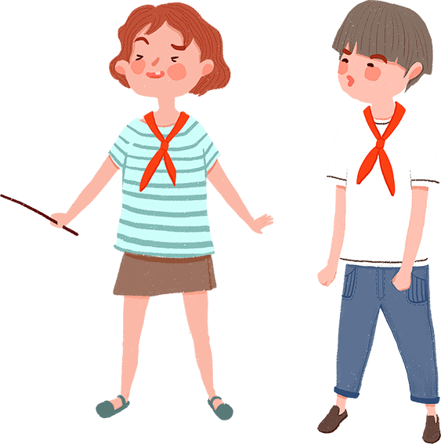
TWO 重要课程
…………
标题文本预设
We are all too young, a lot of things don't yet know, don't put the wrong loves when gardeners.
……
………
The life most of the time, commitments equals to constrain, reluctantly we yearn for bound.
PPT模板 http://www.ypppt.com/moban/

Slide 11
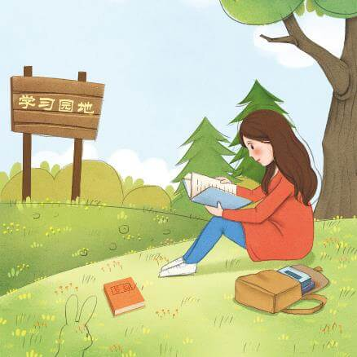
TWO 重要课程
…………
添加此处标题
请在此处添加具体内容，文字尽量言简意赅，简单说明。
We are all too young, a lot of things don’t yet know, don't put the wrong loves when gardeners.
添加此处标题
We are all too young, a lot of things don’t yet know, don't put the wrong loves when gardeners.
……
………

Slide 12
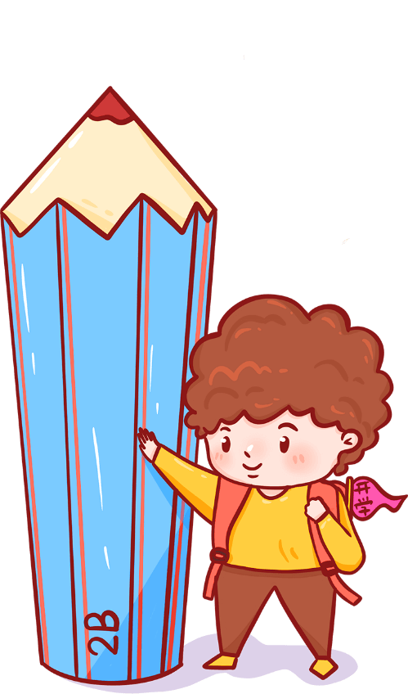
TWO 重要课程
…………
添加此处标题
请在此处添加具体内容，文字尽量言简意赅，简单说明即可。
……
We are all too young, a lot of things don’t yet know.
………
Gentle to have, but not compromise, I want to be in quiet.
Please allow me to small proud, because like you depend on.
Notes:
https://www.ypppt.com/

Slide 13
…………
THREE
班级活动
Please allow me to small proud, because like you depend on.
……
………

Slide 14
THREE 班级活动
…………
添加此处标题
请在此处添加具体内容，
文字尽量言简意赅，简单说明。
……
………
We are all too young, a lot of things don’t yet know,
don't put the wrong loves when gardeners.

Slide 15
THREE 班级活动
…………
标题文本
标题文本
We are all too young, a lot of things don't yet know.
We are all too young, a lot of things don't yet know.
标题文本
标题文本
……
………
We are all too young, a lot of things don't yet know.
We are all too young, a lot of things don't yet know.

Slide 16
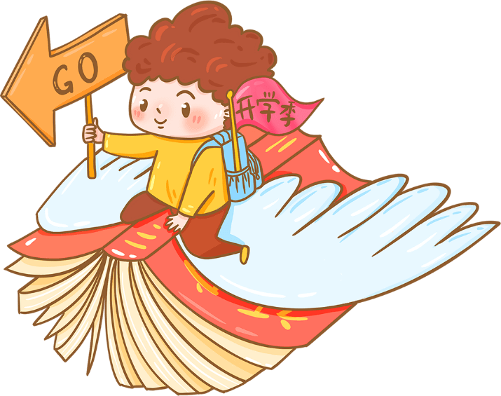
THREE 班级活动
…………
01
02
添加此处标题
添加此处标题
We are all too young, a lot of things don’t yet know,
don't put the wrong loves when gardeners.
We are all too young, a lot of things don’t yet know,
don't put the wrong loves when gardeners.
……
………

Slide 17
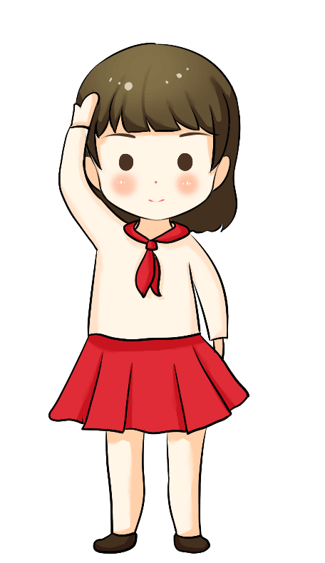
THREE 班级活动
…………
We are all too young, a lot of things don’t yet know.
输入标题
We are all too young, a lot of things don’t yet know.
输入标题
We are all too young, a lot of things don’t yet know.
输入标题
……
………
We are all too young, a lot of things don’t yet know.
输入标题

Slide 18
…………
FOUR
注意事项
Please allow me to small proud, because like you depend on.
……
………

Slide 19
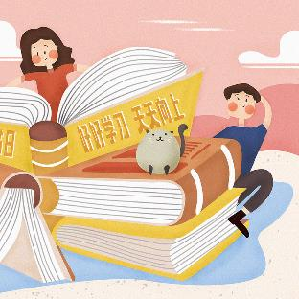
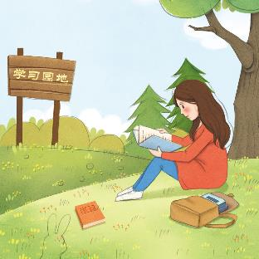
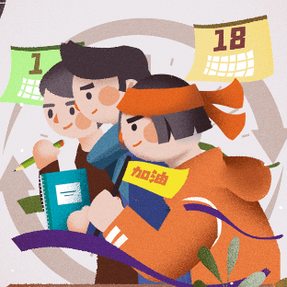
FOUR 注意事项
…………
输入标题
输入标题
We are all too young, a lot of things don’t yet know.
We are all too young, a lot of things don’t yet know.
……
………
输入标题
输入标题
We are all too young, a lot of things don’t yet know.
We are all too young, a lot of things don’t yet know.

Slide 20
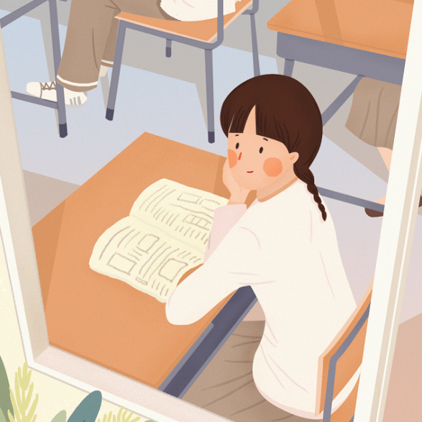
FOUR 注意事项
…………
添加标题
We are all too young, a lot of things don’t yet know, don't put the wrong loves when gardeners.
……
添加标题
………
We are all too young, a lot of things don’t yet know, don't put the wrong loves when gardeners.

Slide 21
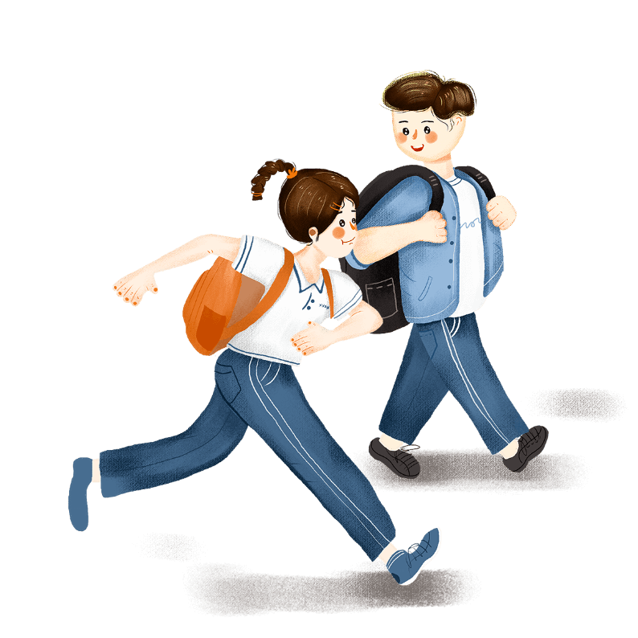
FOUR 注意事项
…………
添加此处标题
请在此处添加具体内容，
文字尽量言简意赅，简单说明。
……
………
We are all too young, a lot of things don’t yet know,
don't put the wrong loves when gardeners.

Slide 22
FOUR 注意事项
…………
添加标题
添加标题
……
………
We are all too young, a lot of things
don’t yet know, don't put.
We are all too young, a lot of things
don’t yet know, don't put.

Slide 23
FOUR 注意事项
…………
添加此处标题
请在此处添加具体内容，
文字尽量言简意赅，简单说明。
……
We are all too young, a lot of things don’t
yet know, don't put the wrong loves when gardeners.
………

Slide 24
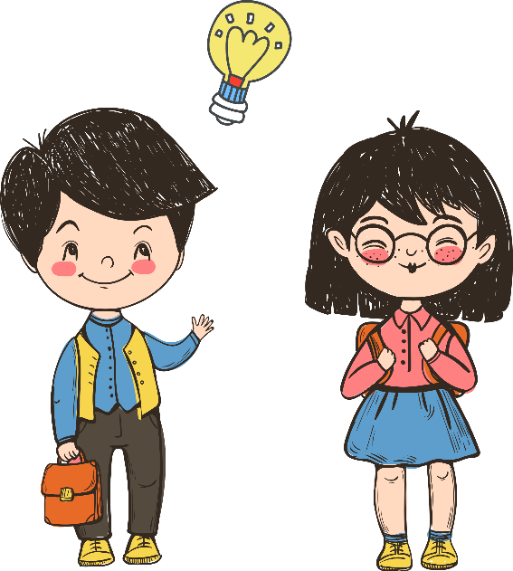
FOUR 注意事项
…………
01
02
We are all too young, a lot of things don’t yet know, don't.
We are all too young, a lot of things don’t yet know, don't.
03
04
……
………
We are all too young, a lot of things don’t yet know, don't.
We are all too young, a lot of things don’t yet know, don't.

Slide 25
…………
感
谢
您
欣
赏
{新学期|新气象|教学课件|主题班会}
……
汇报教师：ppt营
………

Slide 26
10000+套精品PPT模板全部免费下载
PPT营
www.pptying.com
Notes:
模板来自于 https://www.pptying.com 【PPT营】

