Slide 1








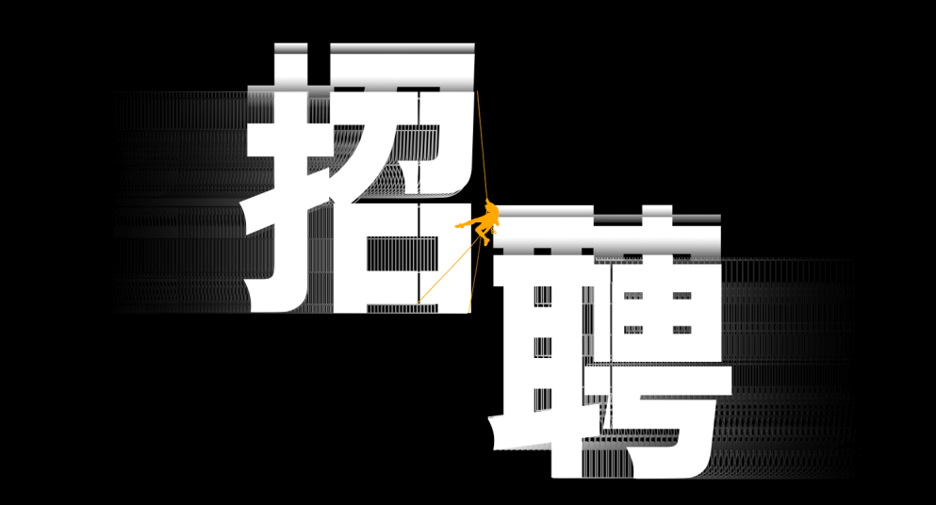



20XX招聘季
JION US
RECRUITMENT
——SPACE DREAM——
不忘初心 为自己加油

Slide 2


https://www.ypppt.com/
1
关于我们
Gentle to have, but not compromise.
目 录
2
招聘计划
CONTENTS
Gentle to have, but not compromise.
3
薪资福利
Gentle to have, but not compromise.
4
招聘流程
Gentle to have, but not compromise.

Slide 3

关于我们
01
Gentle to have, but not compromise, I want to be in quiet, not strong.

Slide 4

1
关于我们
输入您的标题
We are all too young, a lot of things don't yet know, don't put the wrong loves when gardeners.
The life most of the time, commitments equals to constrain, reluctantly we yearn for bound.
The life most of the time, commitments equals to constrain, reluctantly we yearn for bound. We are all too young, a lot of things don't yet know, don't put the wrong loves when gardeners.

Slide 5
1
关于我们
输入标题
输入标题
We are all too young, a lot of things don't yet know, don't put the wrong loves when gardeners.
We are all too young, a lot of things don't yet know.
01
02
03
04
输入标题
输入标题
We are all too young, a lot of things don't yet know, don't put the wrong loves when gardeners.
We are all too young, a lot of things don't yet know, don't put the wrong loves when gardeners.

Slide 6




1
关于我们
输入您的标题
输入您的标题
We are all too young, a lot of things don't yet know, don't put the wrong loves when gardeners.
I'm just a sunflower, waiting for belong to me only sunshine.
We are all too young, a lot of things don't yet know, don't put the wrong loves when gardeners.
I'm just a sunflower, waiting for belong to me only sunshine.

Slide 7




1
关于我们
RECRUITMENT
We are all too young, a lot of things don't yet know, don't put the wrong loves when gardeners.
输入标题
输入标题
We are all too young, a lot of things don't yet know, don't put the wrong loves when gardeners.
输入标题
输入标题
We are all too young, a lot of things don't yet know, don't put the wrong loves when gardeners.
I‘m just a sunflower, waiting for b elong to me only sunshine.
I‘m just a sunflower, waiting for b elong to me only sunshine.

Slide 8
招聘计划
02
Gentle to have, but not compromise, I want to be in quiet, not strong.

Slide 9

2
招聘计划
01
输入标题
We are all too young, a lot of things don't yet know, don't put the.
02
输入标题
We are all too young, a lot of things don't yet know, don't put the.
03
输入标题
We are all too young, a lot of things don't yet know, don't put the.
PPT下载 http://www.ypppt.com/xiazai/

Slide 10
2
招聘计划
添加标题
添加标题
I‘m just a sunflower, waiting for b elong to me only sunshine.
04
I‘m just a sunflower, waiting for b elong to me only sunshine.
03
添加标题
02
I‘m just a sunflower, waiting for b elong to me only sunshine.
01
添加标题
I‘m just a sunflower, waiting for b elong to me only sunshine.

Slide 11

2
招聘计划
输入此处标题
We are all too young, a lot of things don't yet know, don't put the wrong loves when gardeners. I‘m just a sunflower, waiting for b elong to me only sunshine.

Slide 12





2
招聘计划
添加标题
We are all too young, a lot of things don't yet know, don't put the wrong loves when gardeners. I‘m just a sunflower, waiting for b elong to me only sunshine.
添加标题
添加标题
添加标题
添加标题
添加标题
Notes:
https://www.ypppt.com/

Slide 13
薪资福利
03
Gentle to have, but not compromise, I want to be in quiet, not strong.

Slide 14




3
薪资福利
输入标题
输入标题
输入标题
输入标题
We are all too young, a lot of things don‘t yet know, don’t put the wrong loves when gardeners.
We are all too young, a lot of things don‘t yet know, don’t put the wrong loves when gardeners.
We are all too young, a lot of things don‘t yet know, don’t put the wrong loves when gardeners.
We are all too young, a lot of things don‘t yet know, don’t put the wrong loves when gardeners.

Slide 15
3
薪资福利
I'm just a sunflower, waiting for belong to me only sunshine.
1
标题添加
I'm just a sunflower, waiting for belong to me only sunshine.
标题添加
2
I'm just a sunflower, waiting for belong to me only sunshine.
3
标题添加
I'm just a sunflower, waiting for belong to me only sunshine.
标题添加
4

Slide 16



3
薪资福利
RECRUITMENT
——SPACE DREAM——
We are all too young, a lot of things don‘t yet know, don’t put the wrong loves when gardeners.
The life most of the time, commitments equals to constrain, reluctantly we yearn for bound. We are all too young, a lot of things don't yet know.
The life most of the time, commitments equals to constrain, reluctantly we yearn for bound. We are all too young, a lot of things don't yet know.
We are all too young, a lot of things don‘t yet know, don’t put the wrong loves when gardeners.

Slide 17

3
薪资福利
We are all too young, a lot of things don‘t yet know, don’t put the wrong loves when gardeners.
4
We are all too young, a lot of things don‘t yet know, don’t put the wrong loves when gardeners.
We are all too young, a lot of things don‘t yet know, don’t put the wrong loves when gardeners.
2
3
We are all too young, a lot of things don‘t yet know, don’t put the wrong loves when gardeners.
1

Slide 18
招聘流程
04
Gentle to have, but not compromise, I want to be in quiet, not strong.

Slide 19



4
招聘流程
We are all too young, a lot of things don‘t yet know, don’t put the wrong loves when gardeners.
输入标题
输入标题
输入标题
We are all too young, a lot of things don‘t yet know, don’t put the wrong loves when gardeners.
We are all too young, a lot of things don‘t yet know, don’t put the wrong loves when gardeners.

Slide 20




4
招聘流程
输入标题
输入标题
输入标题
输入标题
I'm just a sunflower, waiting for belong to me only sunshine.
We are all too young, a lot of things don‘t yet know, don’t put the wrong loves when gardeners.
I'm just a sunflower, waiting for belong to me only sunshine.
I'm just a sunflower, waiting for belong to me only sunshine.

Slide 21

4
招聘流程
输入标题
I'm just a sunflower, waiting for belong to me only sunshine.
输入标题
输入标题
I'm just a sunflower, waiting for belong to me only sunshine.
在此输入你的内容
We are all too young, a lot of things don‘t yet know.
I'm just a sunflower, waiting for belong to me only sunshine.

Slide 22

4
招聘流程
RECRUITMENT
——SPACE DREAM——
We are all too young, a lot of things don‘t yet know, don’t put the wrong loves when gardeners.
输入标题
输入标题
输入标题

Slide 23

4
招聘流程
1
输入标题
3
输入标题
We are all too young, a lot of things don‘t yet know, don’t put the wrong loves when gardeners.
We are all too young, a lot of things don‘t yet know, don’t put the wrong loves when gardeners.
2
输入标题
4
输入标题
We are all too young, a lot of things don‘t yet know, don’t put the wrong loves when gardeners.
We are all too young, a lot of things don‘t yet know, don’t put the wrong loves when gardeners.

Slide 24

4
招聘流程
We are all too young, a lot of things don‘t yet know, don’t put the wrong loves when gardeners.
输入标题
We are all too young, a lot of things don‘t yet know, don’t put the wrong loves when gardeners.
输入标题
We are all too young, a lot of things don‘t yet know, don’t put the wrong loves when gardeners.
输入标题

Slide 25

加入我们
追逐梦想
欢迎你的到来
We are all too young, a lot of things don't yet know, don't put the wrong loves when gardeners.
——SPACE DREAM——

Slide 26

10000+套精品PPT模板全部免费下载
PPT营
www.pptying.com
Notes:
模板来自于 https://www.pptying.com 【PPT营】

