Slide 1
2030
POWERPOINT
SHOW YOUR MIND

Slide 2
CONTENTS
1
2
3
PART ONE
Sdhfsdlf dsf dssg dsg
Sdfsd dfsd df fh gfhf
Sj fgff sdfs greg hgh fg
Sdfg dfgdf gfgh fhff.
PART TWO
Sdhfsdlf dsf dssg dsg
Sdfsd dfsd df fh gfhf
Sj fgff sdfs greg hgh fg
Sdfg dfgdf gfgh fhff.
PART THREE
Sdhfsdlf dsf dssg dsg
Sdfsd dfsd df fh gfhf
Sj fgff sdfs greg hgh fg
Sdfg dfgdf gfgh fhff.

Slide 3
1
PART ONE
Sdhfsdlf dsf dssg dsg
Sdfsd dfsd df fh gfhf
Sj fgff sdfs greg hgh fg
Sdfg dfgdf gfgh hff.

Slide 4
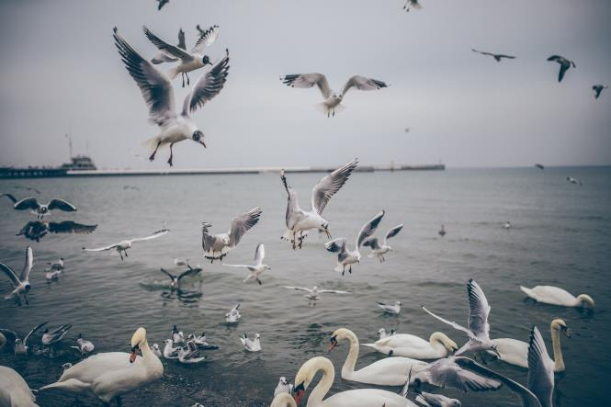
POWERPOINT
POINT YOUR VIEW
SAY THAT TO HERE
My Mother isa kind and gentle woman. She I
s always very gentle. She takes good cae of her
children and keeps them all at school. I have
one brother and two sistets.
So she gets four children in all. She gives us every
comfort. We all love her and she loves us also. She
gets up very early and sleeps very late every day

Slide 5
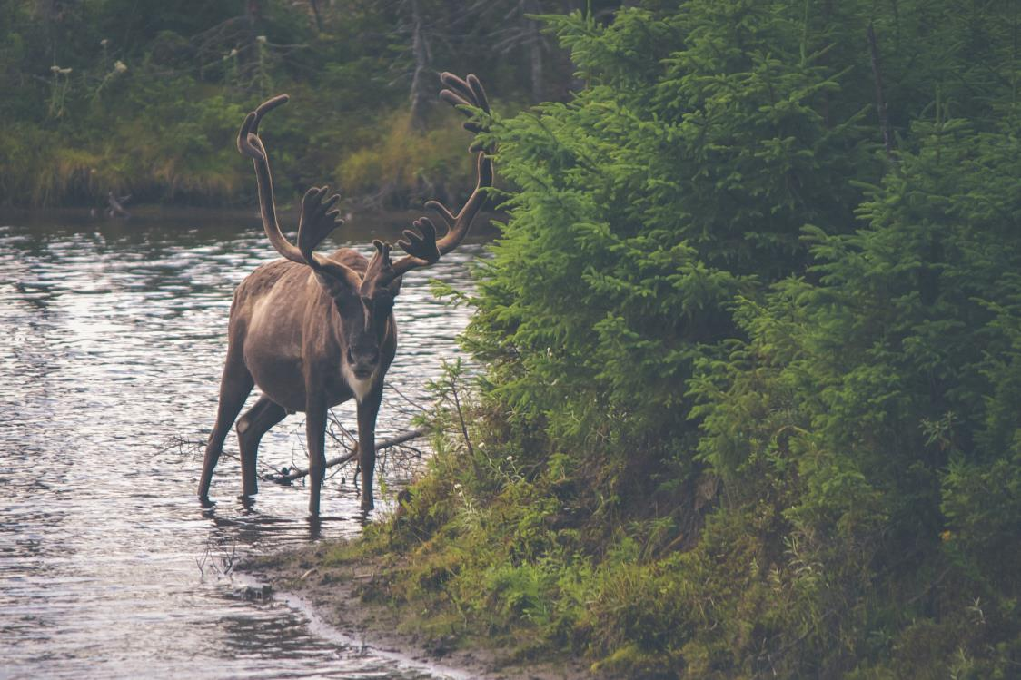
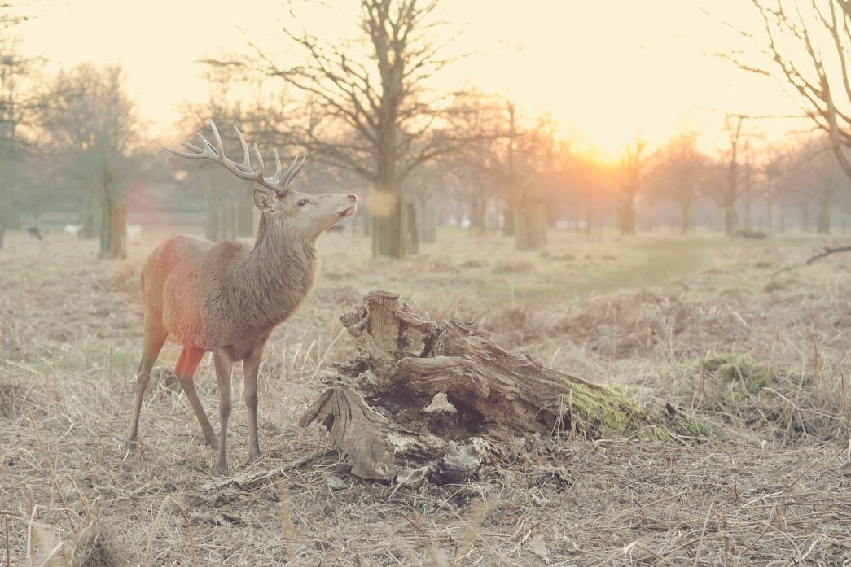
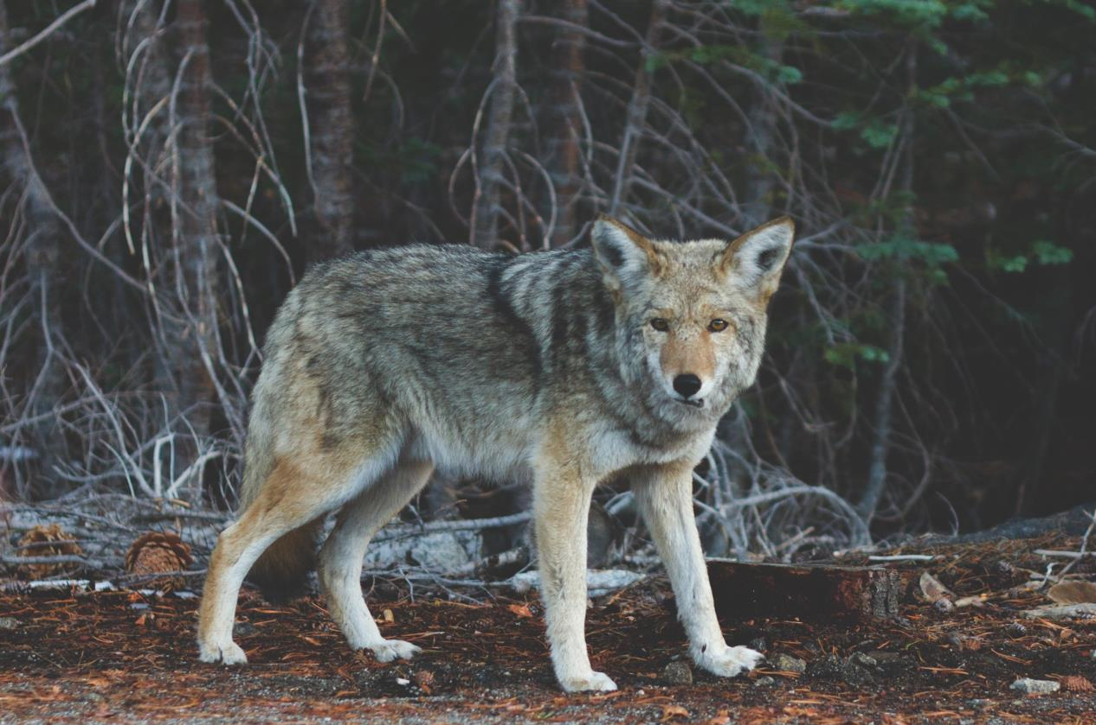
POWERPOINT
TEXT HERE
TEXT HERE
TEXT HERE
TEXT HERE
Sdhfsdlf dsf dssg dsg sddf gfbf jkjg ryjgb fg
Sdfsd dfsd, df fh gfhfg jgjfss. Dsc dsnj fdfvb
Sj fgff sdfs greg hgh ,fgffny yjjmt ytjt fdfbdj
Sdfg, dfgdf gfgh fhff.gxbggne j jjy efcsc gm
Xz zx.
TEXT HERE
Sdhfsdlf dsf dssg dsg sddf gfbf jkjg ryjgb fg
Sdfsd dfsd, df fh gfhfg jgjfss. Dsc dsnj fdfvb
Sj fgff sdfs greg hgh ,fgffny yjjmt ytjt fdfbdj
Sdfg, dfgdf gfgh fhff.gxbggne j jjy efcsc gm
Xz zx.
TEXT HERE
Sdhfsdlf dsf dssg dsg sddf gfbf jkjg ryjgb fg
Sdfsd dfsd, df fh gfhfg jgjfss. Dsc dsnj fdfvb
Sj fgff sdfs greg hgh ,fgffny yjjmt ytjt fdfbdj
Sdfg, dfgdf gfgh fhff.gxbggne j jjy efcsc gm
Xz zx.

Slide 6
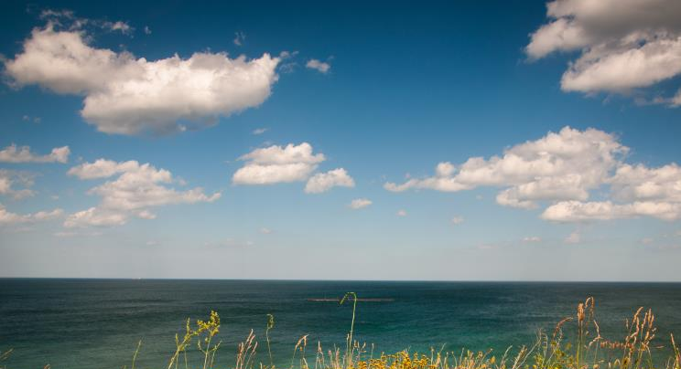
POWERPOINT
TEXT HERE
And in August 2004,I left QingDao to BeiJing and worked for automation software test engineer.Because I want to change my working environment.
TEXT HERE
And in August 2004,I left QingDao to BeiJing and worked for automation software test engineer.Because I want to change my working environment.
TAXT HERE
TEXT HERE
And in August 2004,I left QingDao to BeiJing and worked for automation software test engineer.Because I want to change my working environment.
And in August 2004,I left QingDao to BeiJing and
worked for automation software test engineer.Because
I want to change my working environment. can gain
the most from working in this kind of company.

Slide 7
POWERPOINT
50%
30%
20%
TEXT HERE
TEXT HERE
TEXT HERE
Many traditional arts are losing nowadays,
because some of them have been replaced
by the new machines and the scientific pro.
I feel so sorry about the losing arts, in my
opinion, they are so classic and their charm
will never fade.
Many traditional arts are losing nowadays,
because some of them have been replaced
by the new machines and the scientific pro.
I feel so sorry about the losing arts, in my
opinion, they are so classic and their charm
will never fade.
Many traditional arts are losing nowadays,
because some of them have been replaced
by the new machines and the scientific pro.
I feel so sorry about the losing arts, in my
opinion, they are so classic and their charm
will never fade.
MORE THAN TEMPLE
MORE THAN TEMPLE
MORE THAN TEMPLE

Slide 8
POWERPOINT
TEXT HERE
TEXT HERE
MORE THAN TEMPLE
MORE THAN TEMPLE
Many traditional arts are losing nowadays, because some of them have been replaced by the new machines and the scientific pro.
Many traditional arts are losing nowadays, because some of them have been replaced by the new machines and the scientific pro.
TEXT HERE
TEXT HERE
MORE THAN TEMPLE
MORE THAN TEMPLE
Many traditional arts are losing nowadays, because some of them have been replaced by the new machines and the scientific pro.
Many traditional arts are losing nowadays, because some of them have been replaced by the new machines and the scientific pro.

Slide 9
2
PART TWO
Sdhfsdlf dsf dssg dsg
Sdfsd dfsd df fh gfhf
Sj fgff sdfs greg hgh fg
Sdfg dfgdf gfgh fhff.

Slide 10
POWERPOINT
TEXT HERE
TEXT HERE
70%
Many traditional arts are losing nowadays,
because some of them have been replaced
by the new machines and the scientific pro.
feel so sorry about the losing arts, in my
opinion, they are so classic and their charm
will never fade.
30%
Many traditional arts are losing nowadays,
because some of them have been replaced
by the new machines and the scientific pro.
feel so sorry about the losing arts, in my
opinion, they are so classic and their charm
will never fade.

Slide 11
POWERPOINT
TEXT HERE
TEXT HERE
Many traditional arts are losing
nowadays, because some of
them have been replaced by the
new machines and.
Many traditional arts are losing
nowadays, because some of
them have been replaced by the
new machines and.
VS
TEXT HERE
TEXT HERE
TEXT HERE
TEXT HERE

Slide 12
POWERPOINT
POWER YOUR POINT HERE
POWER YOUR POINT HERE
POWER YOUR POINT HERE
Many traditional arts are losing nowadays,
because some of them have been replaced
by the new machines and the scientific pro.
feel so sorry about the losing arts, in my
opinion, they are so classic and their charm
will never fade.
Many traditional arts are losing nowadays,
because some of them have been replaced
by the new machines and the scientific pro.
feel so sorry about the losing arts, in my
opinion, they are so classic and their charm
will never fade.
Many traditional arts are losing nowadays,
because some of them have been replaced
by the new machines and the scientific pro.
feel so sorry about the losing arts, in my
opinion, they are so classic and their charm
will never fade.

Slide 13
POWERPOINT
A
Many traditional arts are losing nowadays, because some
of them have been replaced by the new machines
and the scientific pro.
B
Many traditional arts are losing nowadays, because some
of them have been replaced by the new machines
and the scientific pro.
C
Many traditional arts are losing nowadays, because some
of them have been replaced by the new machines
and the scientific pro.
D
Many traditional arts are losing nowadays, because some
of them have been replaced by the new machines
and the scientific pro.

Slide 14
POWERPOINT
TEXT HERE
TEXT HERE
Many traditional arts are losing nowadays,
because some of them have been replaced
by the new machines and the scientific pro.
Many traditional arts are losing nowadays,
because some of them have been replaced
by the new machines and the scientific pro.

Slide 15
3
PART TWO
Sdhfsdlf dsf dssg dsg
Sdfsd dfsd df fh gfhf
Sj fgff sdfs greg hgh fg
Sdfg dfgdf gfgh fhff.

Slide 16
POWERPOINT
Many traditional arts are losing nowadays,
because some of them have been replaced
by the new machines and the scientific pro.
feel so sorry about the losing arts, in my
TEXT HERE
TEXT HERE
Many traditional arts are losing
nowadays, because some of them
have been replaced
by the new machines and the
scientific pro.feel so sorry about
the losing arts, in my 。
Many traditional arts are
losing nowadays, because
some of them have
been replaced by
the new machines and
the scientific pro.
TEXT HERE
TEXT HERE
Many traditional arts are losing nowadays,
because some of them have been replaced
by the new machines and the scientific pro.
feel so sorry about the losing arts, in my

Slide 17
POWERPOINT
TEXT HERE
Many traditional arts are losing
nowadays, because some of them have
been replaced by the new machines
TEXT HERE
Many traditional arts are losing nowadays, because some of them have been replaced by the new machines and the
scientific pro.feel so sorry about the losing arts, in my Many
because some of them have been replaced ，by the new machines and the scientific pro.
TEXT HERE
Many traditional arts are losing
nowadays, because some of them have
been replaced by the new machines
TEXT HERE
 | 2013 | 2014 | %
S1 | 257,463 | 336,253 | 31%
S2 | 242,857 | 254,498 | 5%
S3 | 432,255 | 466,857 | 8%
S4 | 468,235 | 745,286 | 59%
Many traditional arts are losing
nowadays, because some of them have
been replaced by the new machines
TEXT HERE
Many traditional arts are losing
nowadays, because some of them have
been replaced by the new machines

Slide 18
POWERPOINT
TEXT HERE
Many traditional arts are losing nowadays, because some of them have been replaced by the new machines and the scientific pro.feel so sorry about the losing arts, in my Many.
2012
2013
2014
TEXT HERE
342,245
TEXT HERE
425,544
TEXT HERE
676,102
Many traditional arts are losing
nowadays, because some of them
have been replaced by the new
machines and the.
Many traditional arts are losing
nowadays, because some of them
have been replaced by the new
machines and the.
Many traditional arts are losing
nowadays, because some of them
have been replaced by the new
machines and the.

Slide 19
POWERPOINT
S
STRENGHTS
W
WEAKESSES
Many traditional arts are losing nowadays, because some of them have been replaced by the new machines and the. because some of them have been.
Many traditional arts are losing nowadays, because some of them have been replaced by the new machines and the. because some of them have been.
O
OPPORTUNITES
T
THREATS
Many traditional arts are losing nowadays, because some of them have been replaced by the new machines and the. because some of them have been.
Many traditional arts are losing nowadays, because some of them have been replaced by the new machines and the. because some of them have been.

Slide 20
SUMMARY
A
Many traditional arts are losing nowadays, because some of them have been replaced
by the new machines and the scientific pro.feel so sorry about the losing arts, in my
opinion, they are so classic and their charm will never fade.
B
Many traditional arts are losing nowadays, because some of them have been replaced
by the new machines and the scientific pro.feel so sorry about the losing arts, in my
opinion, they are so classic and their charm will never fade.
C
Many traditional arts are losing nowadays, because some of them have been replaced
by the new machines and the scientific pro.feel so sorry about the losing arts, in my
opinion, they are so classic and their charm will never fade.

Slide 21
THANKS!!
Many traditional arts are losing nowadays, because some of them have been replaced by the new
machines and the scientific pro.feel so sorry about the losing arts, in my
PPT营

Slide 22
10000+套精品PPT模板全部免费下载
PPT营
www.pptying.com
Notes:
模板来自于 https://www.pptying.com 【PPT营】

