Slide 1


WE ARE THE AON ONE
BUSSINES POWNRPPSC DSIENS

Slide 2

THE AON ONE
WE ARE THE AON ONE
WE ARE THE AON ONE
THE AON ONE
WE ARE THE AON ONE
We Are The Aon One Dsffsfasd
Dasda Fq Qwdq Wqdas Asd As Dafwdasdasdasdasdasfa
Asda Sda Fa Dasfas Agacasadafs
asdascac
WE ARE THE AON ONE
WE ARE THE AON ONE
WE ARE THE AON ONE
WE ARE THE AON ONE
We Are The Aon One D
Dasda Fq Qwdq WqdasDafwdasdasdasdasdasfa
We Are The Aon One D
Dasda Fq Qwdq WqdasDdasdasdasdasfa
We Are The Aon One D
Dasda Fq QwdqWafwdasasdasfa
We Are The Aon One D
Dasda Fq Qwdq WqdasDafwdasdsdasfa

Slide 3
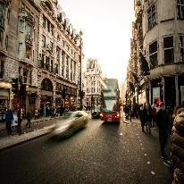
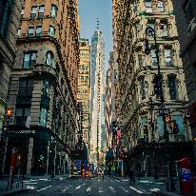

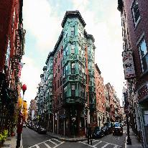
SSDA THE AON ONE
WE ARE THE AON ONE
WE ARE THE
WE ARE THE
WE ARE THE
WE ARE THE
We Are The Aon One D
Dasda Fq Qwdq WqdasDafwdasdasdasdasdasfa
We Are The Aon One D
Dasda Fq Qwdq WqdasDafwdasdasdasdasdasfa
We Are The Aon One D
Dasda Fq Qwdq WqdasDafwdasdasdasdasdasfa
We Are The Aon One D
Dasda Fq Qwdq WqdasDafwdasdasdasdasdasfa

Slide 4
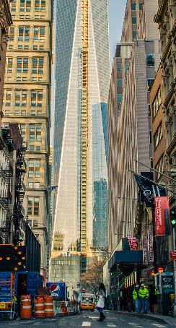

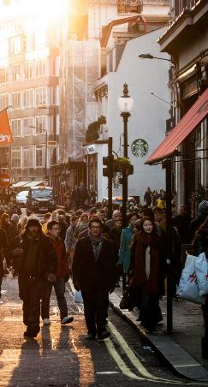
PONAG SSDA AON ONE
WE ARE THE AON ONE ADFGAS
We Are The Aon One Dsffsfasdcsadasdas
Dasda Fq Qwdq Wqdas AsdAs Dafwdasdasdasdasdasfa
THE AON ONE
WqdasDafwdasdasdasdasdasfaasda asda sjsakanckascacasc
THE AON ONE
WqdasDafwdasdasdasdasdasfaasda asda sjsakanckascacasc
THE AON ONE
WqdasDafwdasdasdasdasdasfaasda asda sjsakanckascacasc

Slide 5
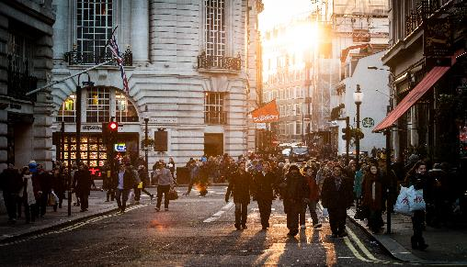
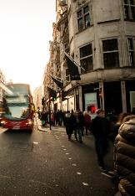
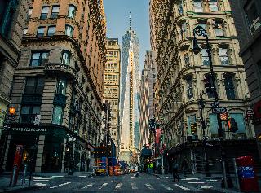
PONAG SSDA AON ONE
WE ARE THE AON ONE ADFGAS
45%
75%
45%
45%
PONAG SSDA AON ONE
WE ARE THE AON ONE ADFGAS
A Boy and His Tree
A long time ago, there was a huge apple tree. A little boy loved to come and play around it every up

Slide 6
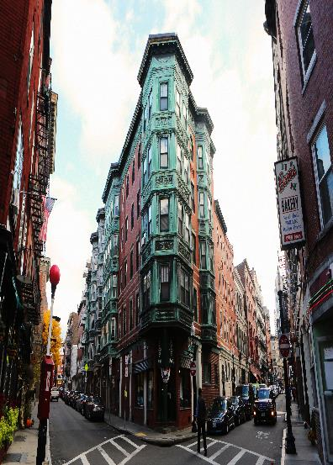
PONAG SSDA AON ONE
WE ARE THE AON ONE ADFGAS
WE ARE THE AON
WE ARE THE AON
A Boy and His Tree
A long time ago, there was a huge apple tree. A little boy loved to come and play
A Boy and His Tree
A long time ago, there was a huge apple tree. A little boy loved to come and play
WE ARE THE AON
WE ARE THE AON
A Boy and His Tree
A long time ago, there was a huge apple tree. A little boy loved to come and play
A Boy and His Tree
A long time ago, there was a huge apple tree. A little boy loved to come and play

Slide 7
PONAG SSDA AON ONE
WE ARE THE AON ONE ADFGAS
WE ARE THE AON
WE ARE THE AON
A Boy and His Tree
A long time ago, there was a huge apple tree. A little boy loved to come and play
A Boy and His Tree
A long time ago, there was a huge apple tree. A little boy loved to come and play
WE ARE THE AON
A Boy and His Tree
A long time ago, there was a e apple tree. A little boy loved tcome and play
WE ARE THE AON
A Boy and His Tree
A long time ago, there was a huge apple tree. A little boy loved to come and play
WE ARE THE AON
A Boy and His Tree
A long time ago, there was a huge apple tree. A little boy loved to come and play
WE ARE THE AON
A Boy and His Tree
A long time ago, there was a apple tree. A little boy loved tocome and play

Slide 8
PONAG SSDA AON ONE
WE ARE THE AON ONE ADFGAS
AON ONE
01
AON ONE
04
A Boy and His Tree
A long time ago, there was a huge apple tree. A little boy loved to come and play
A Boy and His Tree
A long time ago, there was a huge apple tree. A little boy loved to come and play
AON ONE
02
AON ONE
03
A Boy and His Tree
A long time ago, there was a huge apple tree. A little boy loved to come and play
A Boy and His Tree
A long time ago, there was a huge apple tree. A little boy loved to come and play

Slide 9
PONAG SSDA AON ONE
WE ARE THE AON ONE ADFGAS
PONAG SSDA AON ONE
WE ARE THE AON ONE ADFGA
WE ARE THE
WE ARE THE
A Boy and His Tree
A long time ago, there was a huge apple tree. A little boy loved to come and play around it every up
A Boy and His Tree
A long time ago, there was a huge apple tree. A little boy loved to come and play around it every up
A Boy and His Tree
A long time ago, there was a huge apple tree. A little boy loved to come and play around it every up
WE ARE THE
WE ARE THE
A Boy and His Tree
A long time ago, there was a huge apple tree. A little boy loved to come and play around it every up

Slide 10

PONAG SSDA AON ONE
WE ARE THE AON ONE ADFGAS
A BOY AND HIS TREE
A LONG TIME AGO, THERE WAS A HUGE APPLE TREE. A LITTLE BOY LOVED TO COME AND PLAY AROUND IT EVERY UP

Slide 11
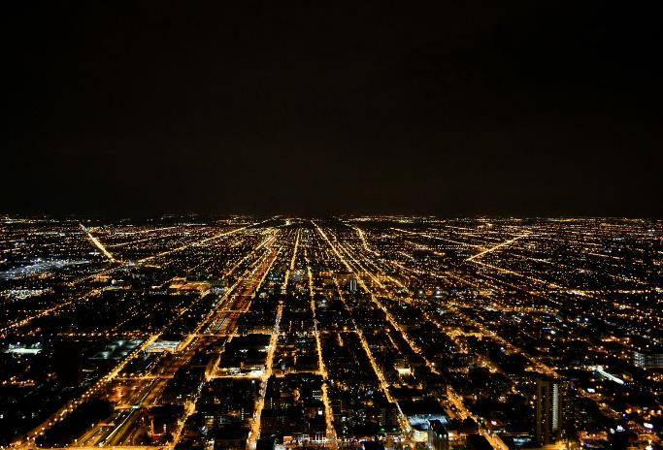
PONAG SSDA AON ONE
WE ARE THE AON ONE ADFGAS
AON ONE SDSDC FSD
AON ONE SDSDC FSD SUDNC CJAKXXIX SXCKVMV VMSXXAKICM CMSIFJDKL SJCJICLC,ALCAMCAL
AON ONE SDSDC FSD
PONAG
SSDA AON ONE ADCF
A Boy and His Tree
A long time ago, there was a huge apple tree. A little boy loved to come and playd a sada dasasdasfasfffffffffffsfffffa wadas d sd asda fsa fasga

Slide 12
PONAG SSDA AON ONE
WE ARE THE AON ONE ADFGAS
PONAG SSD 03
PONAG SSD 01
PONAG SSD 02
￥2000，000
/month
￥2000，000
/month
￥2000，000
/month
PONAG SSD 03
PONAG SSD 03
PONAG SSD 03
PONAG SSD 03
PONAG SSD 03
PONAG SSD 03
PONAG SSD 03
PONAG SSD 03
PONAG SSD 03
PONAG SSD 03
PONAG SSD 02
PONAG SSD 01

Slide 13
PONAG SSDA AON ONE
WE ARE THE AON ONE ADFGAS
PONAG SSDA AON ONE
A Boy and His Tree
A long time ago, there was a huge apple tree. A little boy loved to come and play around it every up
PONAG
SSDA AON ONE
01
02
03
WE ARE THE AON
WE ARE THE AON
WE ARE THE AON
A Boy and His Tree
A long time ago, there was a huge apple tree.
A Boy and His Tree
A long time ago, there was a huge apple tree.
A Boy and His Tree
A long time ago, there was a huge apple tree.

Slide 14
PONAG SSDA AON ONE
WE ARE THE AON ONE ADFGAS
AG SSA AON ONE
AG SSA AON ONE
AG SSA AON ONE
was a huge apple trA Boy and His Treessaxascasca
A long time ago, there ee.
was a huge apple trA Boy and His Treessaxascasca
A long time ago, there ee.
was a huge apple trA Boy and His Treessaxascasca
A long time ago, there ee.
AG SSA AON ONE
AG SSA AON ONE
AG SSA AON ONE
was a huge apple trA Boy and His Treessaxascasca
A long time ago, there ee.
was a huge apple trA Boy and His Treessaxascasca
A long time ago, there ee.
was a huge apple trA Boy and His Treessaxascasca
A long time ago, there ee.

Slide 15
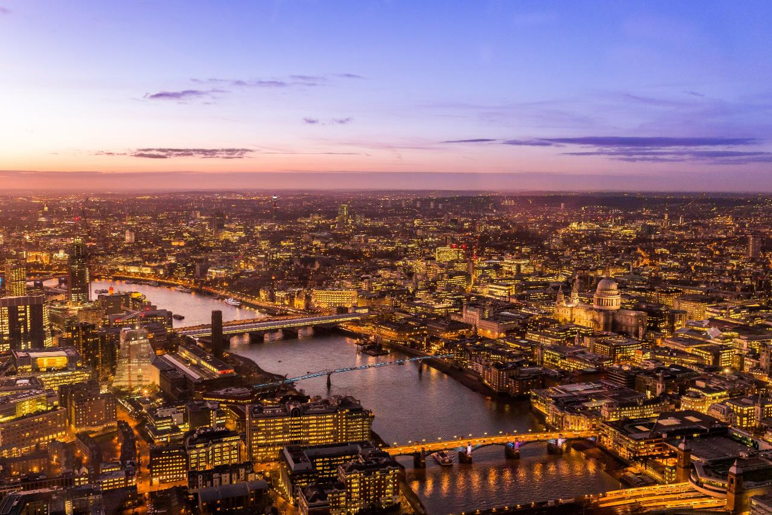
AON ONE
PONAG SSDA
WE ARE THE AON ONE
ADFGAS
WE ARE THE AON
WE ARE THE AON
A Boy and His Tree
A long time ago, there was a huge apple tree. A little boy loved to come and play
A Boy and His Tree
A long time ago, there was a huge apple tree. A little boy loved to come and play

Slide 16

PONAG SSDA AON ONE
WE ARE THE AON ONE ADFGAS
WE ARE THE AON ONE ADFGAS
A Boy and His Tree
A long time ago, there was a huge apple tree. A little boy loved to come and play around it every up
tree. A little boy loved to come an play around it every up
WE ARE THE AON ADFGAS
04
WE ARE THE AON ADFGAS
03
WE ARE THE AON ADFGA0
02
WE ARE THE AON ADFGAS
01
A Boy and His Tree
A long time ago, there was a huge apple tree. A little boy loved to come and play around it every up
A Boy and His Tree
A long time ago, there was a huge apple tree. A little boy loved to come and play around it every up
A Boy and His Tree
A long time ago, there was a huge apple tree. A little boy loved to come and play around it every up
A Boy and His Tree
A long time ago, there was a huge apple tree. A little boy loved to come and play around it every up

Slide 17
PONAG SSDA AON ONE
WE ARE THE AON ONE ADFGAS

Slide 18
PONAG SSDA AON ONE
WE ARE THE AON ONE ADFGAS
3.1
3.1
3.1
2.1
2.1
2.1
1.1
1.1
1.1
5.1
5.1
5.1
WE ARE THE AON
WE ARE THE AON
WE ARE THE AON
A Boy and His Tree
A long time ago, there was a huge apple tree.
A Boy and His Tree
A long time ago, there was a huge apple tree.
A Boy and His Tree
A long time ago, there was a huge apple tree.

Slide 19

THANKS

Slide 20

10000+套精品PPT模板全部免费下载
PPT营
www.pptying.com
Notes:
模板来自于 https://www.pptying.com 【PPT营】

