Slide 1






的
假
我
生活
暑
汇报人：xxx

Slide 2
学习篇
总结篇
生活篇
娱乐篇

Slide 3
活
篇
生

Slide 4


LOVELY
打起我的鼓敲起我的锣生活充满节奏感大王叫我来巡山抓个和尚做晚餐这山涧的水无比的甜
LOVELY
打起我的鼓敲起我的锣生活充满节奏感

Slide 5




亲爱的，Darling
May Jesus Christ always be at the center of the new lives you are now starting to build together, that you may know the ways of true love and kindness.

Slide 6

LOVELY
May Jesus Christ always be at the center of the new lives you are now starting to build together, that you may know the ways of true love and kindness.

Slide 7
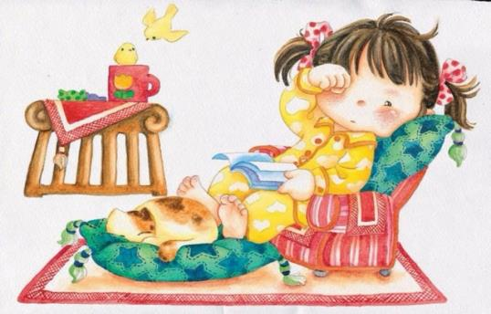
LOVELY
May Jesus Christ always be at the center of the new lives you are now starting to build together, that you may know the ways of true love and kindness.

Slide 8


LOVELY
May Jesus Christ always be at the center of the new lives you are now starting to build together, that you may know the ways of true love and kindness.

Slide 9
习
篇
学

Slide 10



LOVELY
太阳对我眨眼睛鸟儿唱歌给我听

Slide 11


亲爱的，Darling
HELLO
HAPPINESS !
May Jesus Christ always be at the center of the new lives you are now starting

Slide 12

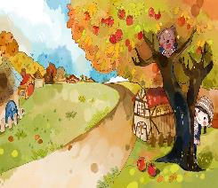

LOVELY
May Jesus Christ always be at the center of the new lives you are now starting to build together, that you may know the ways of true love and kindness.

Slide 13
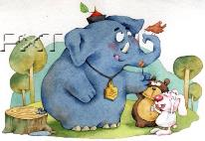

LOVELY
May Jesus Christ always be at the center of the new lives you are now starting to build together

Slide 14

LOVELY
May Jesus Christ always be at the center of the new lives you are now starting to build together, that you may know the ways of true love and kindness.

Slide 15
乐
篇
娱

Slide 16

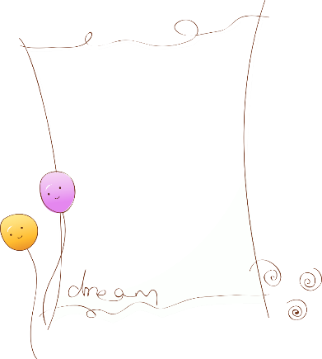
LOVELY
LOVELY
还不粘人的小妖精
别问我从哪里来
也别问我到哪儿去
我要摘下最美的花儿
献给我的小公举

Slide 17


亲爱的，Darling
HELLO
HAPPINESS !
May Jesus Christ always be at the center of the new lives you are now starting

Slide 18

LOVELY
May Jesus Christ always be at the center of the new lives you are now starting to build together, that you may know the ways of true love and kindness.

Slide 19


LOVELY
May Jesus Christ always be at the center of the new lives you are now starting to build together, that you may know the ways of true love and kindness.

Slide 20
结
篇
总

Slide 21
LOVELY
whereby something new and somehow valuable is formed thePhenomenon whereby something new and somehow valuable is formed
LOVELY
太阳对我眨眼睛
鸟儿唱歌给我听
我是一个努力干活儿
还不粘人的小妖精
别问我从哪里来

Slide 22


本页主题
亲爱的，Darling
HELLO
HAPPINESS !
May Jesus Christ always be at the center of the new lives you are now starting

Slide 23

LOVELY
May Jesus Christ always be at the center of the new lives you are now starting to build together, that you may know the ways of true love and kindness.

Slide 24
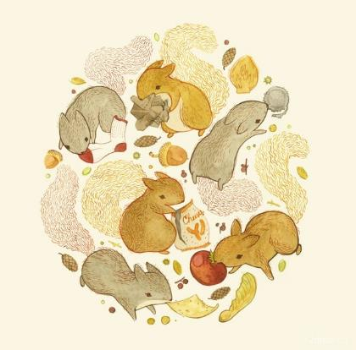
LOVELY
May Jesus Christ always be at the center of the new lives you are now starting to build together, that you may know the ways of true love and kindness.

Slide 25
谢
载
谢
观看
下

Slide 26

10000+套精品PPT模板全部免费下载
PPT营
www.pptying.com
Notes:
模板来自于 https://www.pptying.com 【PPT营】

