Slide 1

20XX
BUSSINESS
单击此处添加标题
Chinadaily cn is the largest English portal in China, providing news, business information, BBS, learning materials. The Website has channels as China.
汇报人：PPT营 时间：XX年XX月

Slide 2

01
年度工作概述
02
工作完成情况
请在此处添加详细描述文本，尽量与标题文本语言风格相符合
请在此处添加详细描述文本，尽量与标题文本语言风格相符合
目
录
03
工作存在不足
04
明年工作计划
请在此处添加详细描述文本，尽量与标题文本语言风格相符合
请在此处添加详细描述文本，尽量与标题文本语言风格相符合

Slide 3
01
年度工作概述
The user can demonstrate on a projector or computer, or print the presentation and make it into a film to be used in a wider

Slide 4


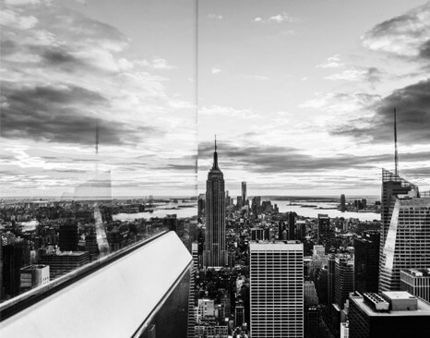
年度工作概述
The user can demonstrate on a projector or computer, or print the presentation and make it into a film to be used in a wider
用户可以在投影仪或者计算机上进行演示也可以将演示文稿打印出来制作成胶片以便应用到更广泛的领域中用户可以在投影仪或者计算机上进行演示也可以将演示文稿打印出来制作成胶片以便应用到更广泛的领域中
标题文字添加
标题文字添加
标题文字添加
用户可以在投影仪或者计算机上进行演示也可以将演示文稿打印出来制作成胶片以便应用到更广泛的领域中
用户可以在投影仪或者计算机上进行演示也可以将演示文稿打印出来制作成胶片以便应用到更广泛的领域中
用户可以在投影仪或者计算机上进行演示也可以将演示文稿打印出来制作成胶片以便应用到更广泛的领域中

Slide 5

年度工作概述
The user can demonstrate on a projector or computer, or print the presentation and make it into a film to be used in a wider
标题文字添加
标题文字添加
The user can demonstrate on a projector or computer, or presentation and make it film to be used in a wider field
The user can demonstrate on a projector or computer, or presentation and make it film to be used in a wider field
标题文字添加
标题文字添加
The user can demonstrate on a projector or computer, or presentation and make it film to be used in a wider field
The user can demonstrate on a projector or computer, or presentation and make it film to be used in a wider field

Slide 6
年度工作概述
The user can demonstrate on a projector or computer, or print the presentation and make it into a film to be used in a wider
The user can demonstrate on a projector or computer, or presnd make it film to be used in a wider field
The user can demonstrate on a projector or computer, or presnd make it film to be used in a wider field
The user can demonstrate on a projector or computer, or presnd make it film to be used in a wider field
02
04
06
01
03
05
The user can demonstrate on a projector or computer, or presnd make it film to be used in a wider field
The user can demonstrate on a projector or computer, or presnd make it film to be used in a wider field
The user can demonstrate on a projector or computer, or presnd make it film to be used in a wider field

Slide 7
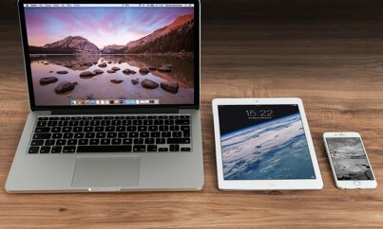


年度工作概述
The user can demonstrate on a projector or computer, or print the presentation and make it into a film to be used in a wider
标题文字添加
标题文字添加
The user can demonstrate on a projector or computer, or presentation and make it film to be used in a wider field
The user can demonstrate on a projector or computer, or presentation and make it film to be used in a wider field
标题文字添加
The user can demonstrate on a projector or computer, or presentation and make it film to be used in a wider field

Slide 8

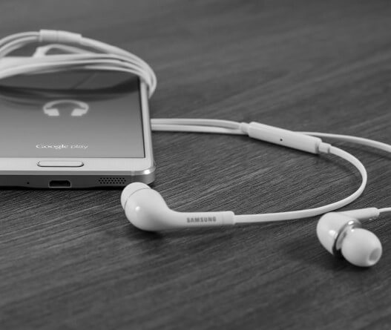
年度工作概述
The user can demonstrate on a projector or computer, or print the presentation and make it into a film to be used in a wider
标题文字添加
标题文字添加
The user can demonstrate on a projector or computer, or presentation and make it film to be used in a wider field
The user can demonstrate on a projector or computer, or presentation and make it film to be used in a wider field

Slide 9
02
工作完成情况
The user can demonstrate on a projector or computer, or print the presentation and make it into a film to be used in a wider

Slide 10
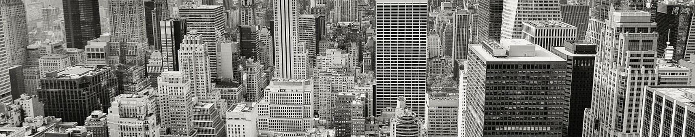
工作完成情况
The user can demonstrate on a projector or computer, or print the presentation and make it into a film to be used in a wider
The user can demonstrate on a projector or computer, or presentation and make it film to be used in a wider field
标题文字添加
标题文字添加
标题文字添加
标题文字添加
The user can demonstrate on a projector or computer, or presentation and make it film to be used in a wider field
The user can demonstrate on a projector or computer, or presentation and make it film to be used in a wider field
The user can demonstrate on a projector or computer, or presentation and make it film to be used in a wider field
The user can demonstrate on a projector or computer, or presentation and make it film to be used in a wider field

Slide 11

工作完成情况
The user can demonstrate on a projector or computer, or print the presentation and make it into a film to be used in a wider
标题文字添加
标题文字添加
标题文字添加
标题文字添加
标题文字添加
标题文字添加
标题文本预设
此部分内容作为文字排版占位显示
（建议使用主题字体）

Slide 12




工作完成情况
The user can demonstrate on a projector or computer, or print the presentation and make it into a film to be used in a wider
标题文字添加
标题文字添加
The user can demonstrate on a projector or computer, or presentation and make it film to be used in a wider field
The user can demonstrate on a projector or computer, or presentation and make it film to be used in a wider field
标题文字添加
标题文字添加
The user can demonstrate on a projector or computer, or presentation and make it film to be used in a wider field
The user can demonstrate on a projector or computer, or presentation and make it film to be used in a wider field

Slide 13




工作完成情况
The user can demonstrate on a projector or computer, or print the presentation and make it into a film to be used in a wider
标题文字添加
用户可以在投影仪或者计算机上进行演示，也可以将演示文稿打印出来，制作成胶片，以便应用到更广泛的领域中。利用Microsoft Office PowerPoint不仅可以创建演示文稿，还可以在互联网上召开面对面会议、远程会议或在网上给观众展示演示文稿
标题文字添加
标题文字添加
标题文字添加
标题文字添加
标题文字添加
标题文字添加
标题文字添加
标题文字添加
标题文字添加
标题文字添加
标题文字添加
标题文字添加

Slide 14
工作完成情况
The user can demonstrate on a projector or computer, or print the presentation and make it into a film to be used in a wider
42%
标题文字添加
标题文字添加
The user can demonstrate on a projector or computer, or presentation and make it film to be used in a wider field
28%
The user can demonstrate on a projector or computer, or presentation and make it film to be used in a wider field
20%
10%
标题文字添加
标题文字添加
The user can demonstrate on a projector or computer, or presentation and make it film to be used in a wider field
The user can demonstrate on a projector or computer, or presentation and make it film to be used in a wider field

Slide 15
03
工作存在不足
The user can demonstrate on a projector or computer, or print the presentation and make it into a film to be used in a wider

Slide 16
工作存在不足
The user can demonstrate on a projector or computer, or print the presentation and make it into a film to be used in a wider
40%
70%
标题文字添加
标题文字添加
The user can demonstrate on a projector or computer, or presentation and make it film to be used in a wider field
The user can demonstrate on a projector or computer, or presentation and make it film to be used in a wider field

Slide 17

工作存在不足
The user can demonstrate on a projector or computer, or print the presentation and make it into a film to be used in a wider
标题文字添加
标题文字添加
The user can demonstrate on a projector or computer, or presentation and make it film to be used in a wider field
The user can demonstrate on a projector or computer, or presentation and make it film to be used in a wider field
标题文字添加
标题文字添加
The user can demonstrate on a projector or computer, or presentation and make it film to be used in a wider field
The user can demonstrate on a projector or computer, or presentation and make it film to be used in a wider field

Slide 18
工作存在不足
The user can demonstrate on a projector or computer, or print the presentation and make it into a film to be used in a wider
标题文字添加
用户可以在投影仪或者计算机上进行演示也可以将演示文稿打印出来制作成胶片用户可以在投影仪
标题文字添加
用户可以在投影仪或者计算机上进行演示也可以将演示文稿打印出来制作成胶片用户可以在投影仪
标题文字添加
用户可以在投影仪或者计算机上进行演示也可以将演示文稿打印出来制作成胶片用户可以在投影仪

Slide 19

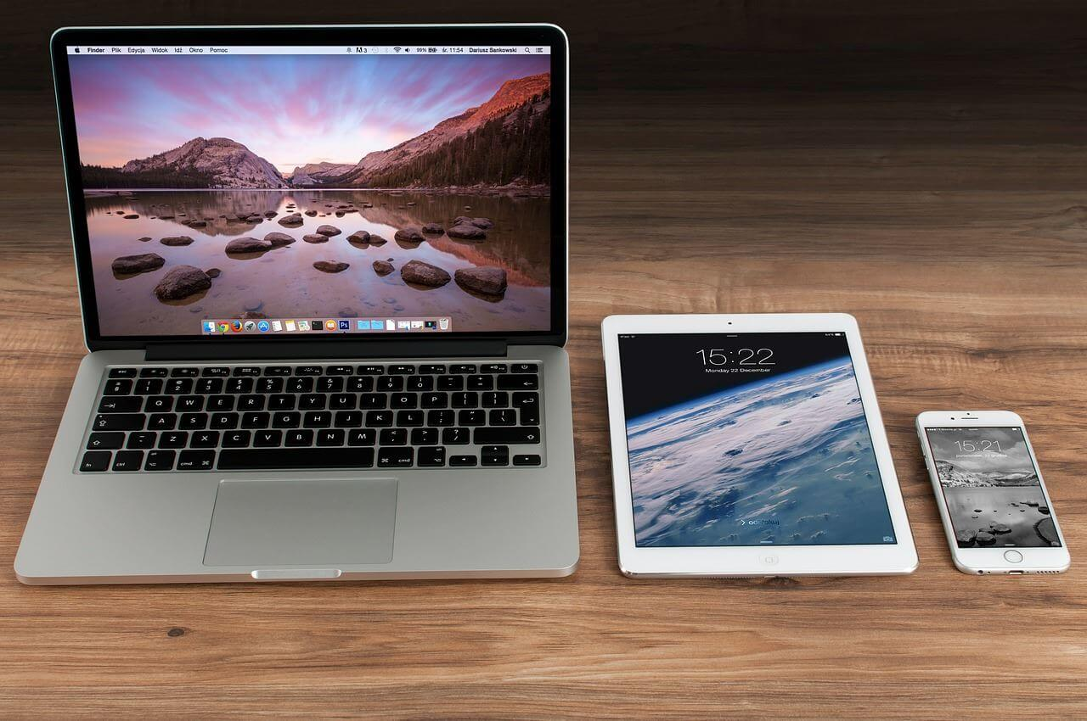

工作存在不足
The user can demonstrate on a projector or computer, or print the presentation and make it into a film to be used in a wider
标题文字添加
The user can demonstrate on a projector or computer, or presentation and make it film to be used in a wider field
标题文字添加
The user can demonstrate on a projector or computer, or presentation and make it film to be used in a wider field
标题文字添加
The user can demonstrate on a projector or computer, or presentation and make it film to be used in a wider field

Slide 20
04
明年工作计划
The user can demonstrate on a projector or computer, or print the presentation and make it into a film to be used in a wider

Slide 21
新年工作计划
The user can demonstrate on a projector or computer, or print the presentation and make it into a film to be used in a wider
The user can demonstrate on a projector or computer, orThe user can demonstrate on a projector or computer, or print the presentation and make it into a film printThe user can demonstrate on a projector or computer, or print the presentation and make it into a film theThe user
标题文字添加
标题文字添加
The user can demonstrate on a projector or computer, or presentation and make it film to be used in a wider field
The user can demonstrate on a projector or computer, or presentation and make it film to be used in a wider field
标题文字添加
标题文字添加
The user can demonstrate on a projector or computer, or presentation and make it film to be used in a wider field
The user can demonstrate on a projector or computer, or presentation and make it film to be used in a wider field

Slide 22



新年工作计划
The user can demonstrate on a projector or computer, or print the presentation and make it into a film to be used in a wider
01
02
03
04
标题文字添加
标题文字添加
标题文字添加
标题文字添加
The user can demonstrate on a projector or computer, or presentation and make it film to be used in a wider field
The user can demonstrate on a projector or computer, or presentation and make it film to be used in a wider field
The user can demonstrate on a projector or computer, or presentation and make it film to be used in a wider field
The user can demonstrate on a projector or computer, or presentation and make it film to be used in a wider field

Slide 23
新年工作计划
The user can demonstrate on a projector or computer, or print the presentation and make it into a film to be used in a wider
The user can demonstrate on a projector or computer, orThe user can demonstrate on a projector or computer, or print the presentation and make it into a film printThe user can demonstrate on a projector or computer, or print the presentation and make it into a film theThe user
标题文字添加
The user can demonstrate on a projector or computer
标题文字添加
The user can demonstrate on a projector or computer
标题文字添加
The user can demonstrate on a projector or computer
标题文字添加
The user can demonstrate on a projector or computer

Slide 24
20XX
BUSSINESS
非常感谢您的观看
Chinadaily cn is the largest English portal in China, providing news, business information, BBS, learning materials. The Website has channels as China.
汇报人：XXX 时间：XX年XX月

Slide 25

10000+套精品PPT模板全部免费下载
PPT营
www.pptying.com
Notes:
模板来自于 https://www.pptying.com 【PPT营】

