Slide 1
The user can demonstrate on a projector or computer, or print the presentation and make it into a film to be used in a wider field
汇报人：xxx

Slide 2
目 录
This template is exclusively designed by Fei er creative
01
03
05
什么是人工智能
人工智能的应用
人工智能的强弱对比
This template is exclusively designed by Fei er creative
This template is exclusively designed by Fei er creative
This template is exclusively designed by Fei er creative
02
04
06
人工智能对生活影响
人工智能的价值研究
人工智能的主要成果
This template is exclusively designed by Fei er creative
This template is exclusively designed by Fei er creative
This template is exclusively designed by Fei er creative

Slide 3
01
什么是人工智能
The user can demonstrate on a projector or computer, or print the presentation and make it into a film to be used in a wider field

Slide 4
标题文字添加
The user can demonstrate on a projector or computer, or presentation and make it film to be used in a wider fieldThe user can demonstrate on a projector or computer, or presentation and make it film to be used in a wider field
标题文字添加
标题文字添加
The user can demonstrate on a projector or computer, or presentation and make it film to be used in a wider field
The user can demonstrate on a projector or computer, or presentation and make it film to be used in a wider field
标题文字添加
标题文字添加
The user can demonstrate on a projector or computer, or presentation and make it film to be used in a wider field
The user can demonstrate on a projector or computer, or presentation and make it film to be used in a wider field

Slide 5
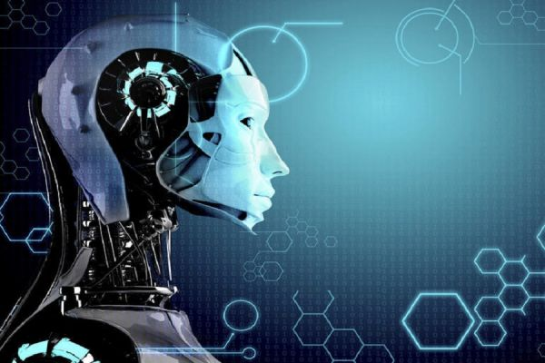
标题文字添加
The user can demonstrate on a projector or computer, or presentation and make it film to be used in a wider field
标题文字添加
The user can demonstrate on a projector or computer, or presentation and make it film to be used in a wider field

Slide 6
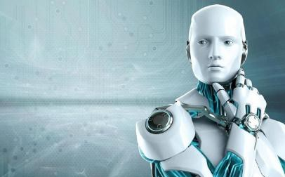
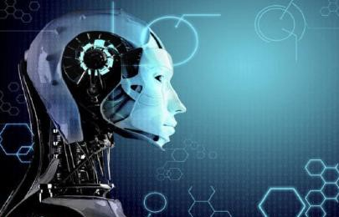
标题文字添加
The user can demonstrate on a projector or computer, or presentation and make it film to be used in a wider fieldThe user can demonstrate on a projector or computer, or presentation and make it film to be used in a wider field
标题文字添加
The user can demonstrate on a projector or computer, or presentation and make it film to be used in a wider fieldThe user can demonstrate on a projector or computer, or presentation and make it film to be used in a wider field

Slide 7
02
人工智能对生活影响
The user can demonstrate on a projector or computer, or print the presentation and make it into a film to be used in a wider field

Slide 8
2017
2018
2019
2020
标题文字添加
标题文字添加
标题文字添加
标题文字添加
The user can demonstrate on a projector or computer, or presentation and make it film to be used in a wider field
The user can demonstrate on a projector or computer, or presentation and make it film to be used in a wider field
The user can demonstrate on a projector or computer, or presentation and make it film to be used in a wider field
The user can demonstrate on a projector or computer, or presentation and make it film to be used in a wider field

Slide 9
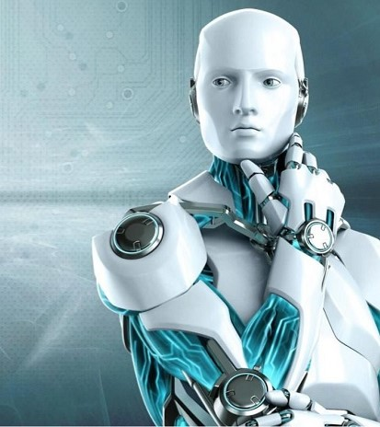
标题文字添加
The user can demonstrate on a projector or computer, or presentation and make it film to be used in a wider fieldThe user can demonstrate on a projector or computer, or presentation and make it film to be used in a wider field
标题文字添加
标题文字添加
The user can demonstrate on a projector or computer, or presentation and make it film to be used in a wider field
The user can demonstrate on a projector or computer, or presentation and make it film to be used in a wider field

Slide 10
添加你的标题
标题文字添加
标题文字添加
The user can demonstrate on a projector or computer, or presentation and make it film to be used in a wider field
The user can demonstrate on a projector or computer, or presentation and make it film to be used in a wider field
用户可以在投影仪或者计算机上进行演示也可以将演示文稿打印出来制作成胶片用户可以在投影仪或者计算机上进行演示也可以将演示文稿打印出来制作成胶片
LEARN MORE
标题文字添加
标题文字添加
The user can demonstrate on a projector or computer, or presentation and make it film to be used in a wider field
The user can demonstrate on a projector or computer, or presentation and make it film to be used in a wider field

Slide 11
03
人工智能的应用
The user can demonstrate on a projector or computer, or print the presentation and make it into a film to be used in a wider field

Slide 12
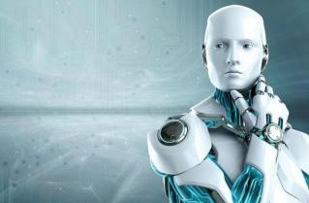
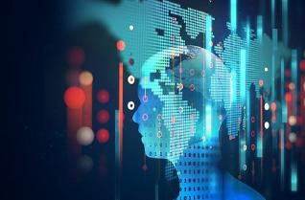
标题文字添加
标题文字添加
标题文字添加
The user can demonstrate on a projector or computer, or presentation and make it film to be used in a wider field
The user can demonstrate on a projector or computer, or presentation and make it film to be used in a wider field
The user can demonstrate on a projector or computer, or presentation and make it film to be used in a wider field

Slide 13
标题文字添加
标题文字添加
The user can demonstrate on a projector or computer, or presentation and make it film to be used in a wider field
The user can demonstrate on a projector or computer, or presentation and make it film to be used in a wider field
标题文字添加
标题文字添加
The user can demonstrate on a projector or computer, or presentation and make it film to be used in a wider field
The user can demonstrate on a projector or computer, or presentation and make it film to be used in a wider field
标题文字添加
标题文字添加
The user can demonstrate on a projector or computer, or presentation and make it film to be used in a wider field
The user can demonstrate on a projector or computer, or presentation and make it film to be used in a wider field

Slide 14
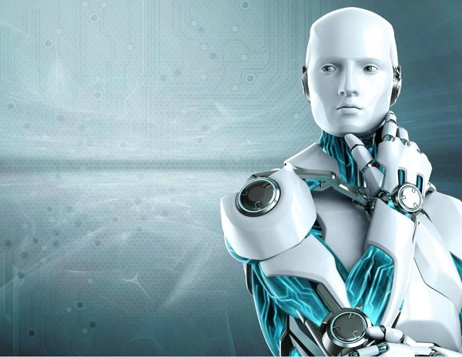
标题文字添加
The user can demonstrate on a projector or computer, or presentation and make it film to be used in a wider field
标题文字添加
The user can demonstrate on a projector or computer, or presentation and make it film to be used in a wider field
标题文字添加
The user can demonstrate on a projector or computer, or presentation and make it film to be used in a wider field

Slide 15
04
人工智能的价值研究
The user can demonstrate on a projector or computer, or print the presentation and make it into a film to be used in a wider field

Slide 16
标题文字添加
The user can demonstrate on a projector or computer, or presentation and make it film to be used in a wider field
标题文字添加
The user can demonstrate on a projector or computer, or presentation and make it film to be used in a wider field
标题文字添加
The user can demonstrate on a projector or computer, or presentation and make it film to be used in a wider field

Slide 17
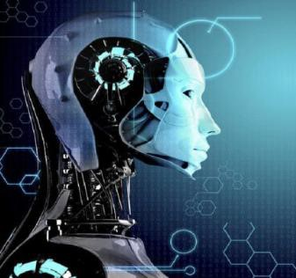
标题文字添加
The user can demonstrate on a projector or computer, or presentation and make it film to be used in a wider field
标题文字添加
The user can demonstrate on a projector or computer, or presentation and make it film to be used in a wider field
标题文字添加
The user can demonstrate on a projector or computer, or presentation and make it film to be used in a wider field

Slide 18
01
02
标题文字添加
标题文字添加
The user can demonstrate on a projector or computer, or presentation and make it film to be used in a wider field
The user can demonstrate on a projector or computer, or presentation and make it film to be used in a wider field
03
04
标题文字添加
标题文字添加
The user can demonstrate on a projector or computer, or presentation and make it film to be used in a wider field
The user can demonstrate on a projector or computer, or presentation and make it film to be used in a wider field

Slide 19
05
人工智能的强弱对比
The user can demonstrate on a projector or computer, or print the presentation and make it into a film to be used in a wider field

Slide 20
90%
80%
70%
60%
50%
45%
标题文字添加
The user can demonstrate on a projector or computer, or presentation and make it film to be used in a wider fieldThe user can demonstrate on a projector or computer, or presentation and make it film to be used in a wider field

Slide 21
06
人工智能的主要成果
The user can demonstrate on a projector or computer, or print the presentation and make it into a film to be used in a wider field

Slide 22
标题文字添加
The user can demonstrate on a projector or computer, or presentation and make it film to be used in a wider field
01
02
03
标题文字添加
标题文字添加
The user can demonstrate on a projector or computer, or presentation and make it film to be used in a wider field
The user can demonstrate on a projector or computer, or presentation and make it film to be used in a wider field

Slide 24
10000+套精品PPT模板全部免费下载
PPT营
www.pptying.com
Notes:
模板来自于 https://www.pptying.com 【PPT营】

