Slide 1
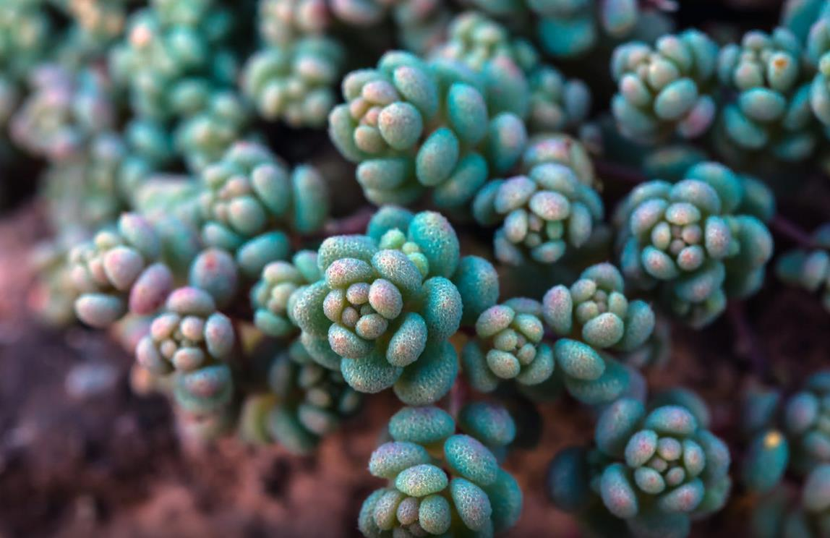
COLORFUL&
VITALITY
PLANT
Plants are very important living things. Life could not go on if there were no plants.
汇报人：

Slide 2
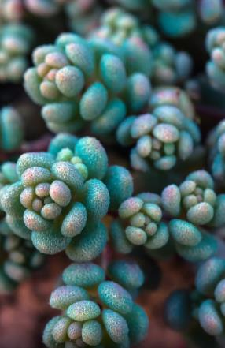
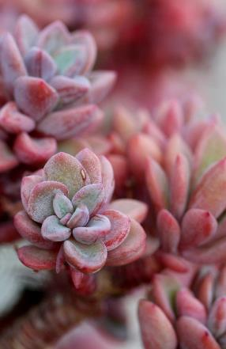
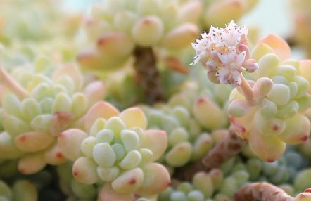
CONTENT
TITLE HERE
TITLE HERE
TITLE HERE

Slide 3
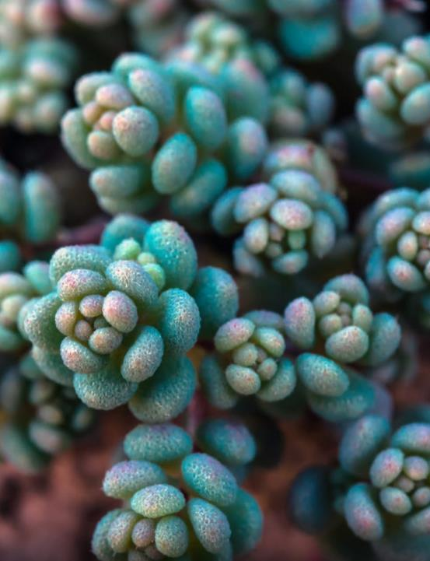
TITLE HERE
TEXT HERE
TEXT HERE
Plants are important living things. Life could not go on if there were no plants.
Plants are important living things. Life could not go on if there were no plants.
TEXT HERE
TEXT HERE
Plants are important living things. Life could not go on if there were no plants.
Plants are important living things. Life could not go on if there were no plants.

Slide 4
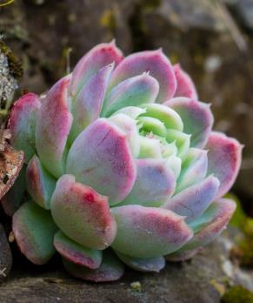
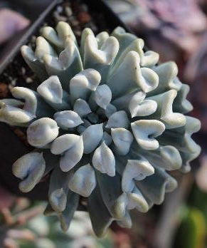
WRITE SOMETHING
ABOUT YOUR
COMPANY
EXAMPLE TEXT HERE
Many cactus species are night blooming,as they are pollinated by nocturnal insects or small animals,principally moths and bats.Cacti range in size from small and globular to tall and columnar.
Cacti come in a wide range of shapes and sizes. The tallest is Pachycereus pringlei, with a maximum recorded height of 19.2 m, and the smallest is Blossfeldia liliputiana,

Slide 5
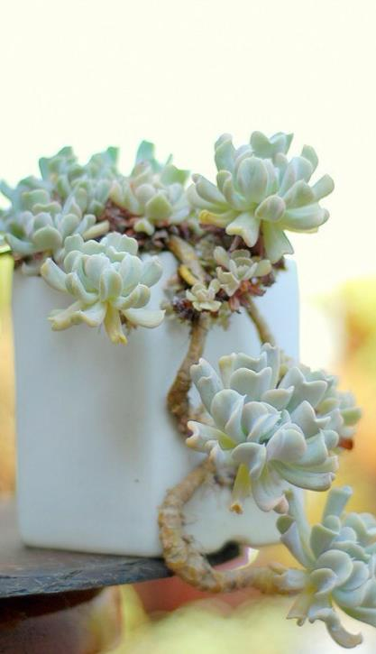
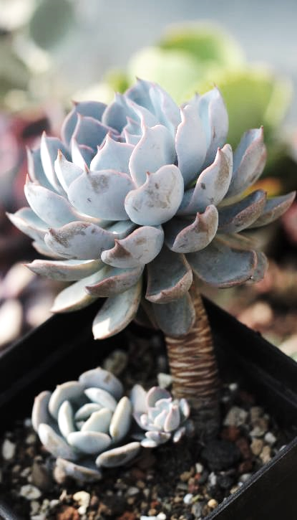
TITLE HERE
Most designers set their type arbitrarily, either by pulling values out of the sky or by adhering to a baseline grid. The former case isn’t worth discussing here, but the latter requires a closer look.

Slide 6
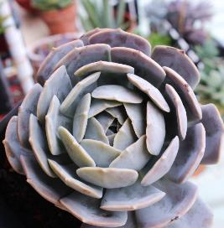
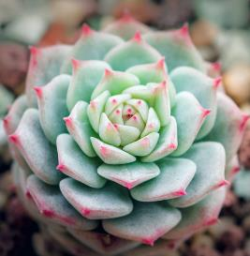
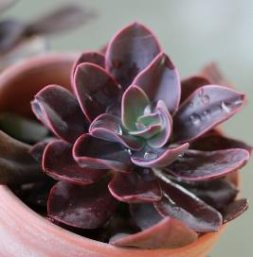
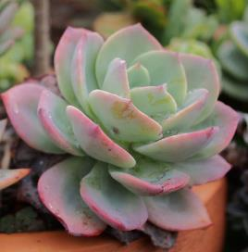
TITLE HERE
Plants are important living things. Life could not go on if there were no plants.
TITLE HERE
TITLE HERE
TITLE HERE
TITLE HERE

Slide 7
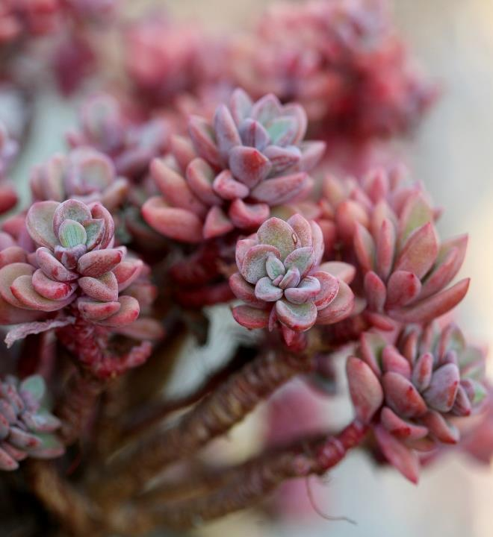
EXAMPLE TEXT HERE
WRITE SOMETHING
ABOUT YOUR
COMPANY
Most designers set their type arbitrarily, either by pulling
Values out of the sky or by adhering to a baseline grid.
The former case isn’t worth discussing here, but the
latter requires a closer look.

Slide 8
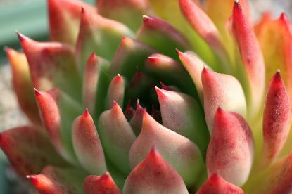
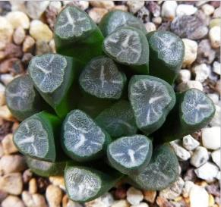
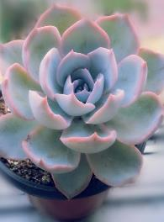
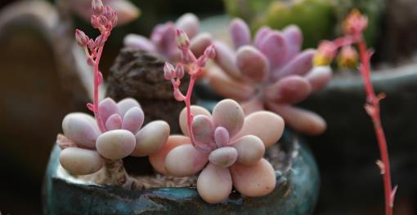
WRITE SOMETHING
HERE
A cactus (plural: cacti or cactuses) is any member of the spine plant family Cactaceae, native to the Americas. They are often used as ornamental plants. Most designers set their type arbitrarily, either by pulling values out of the sky or by adhering to a baseline grid. The former case isn’t worth discussing here, but the latter requires a closer look.

Slide 9
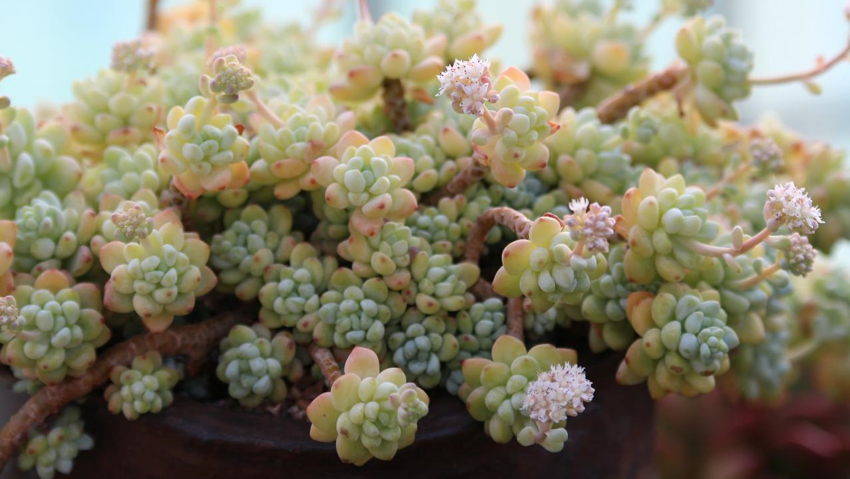
TITLE HERE
Plants are important living things. Life could not go on if there were no plants.
TEXT HERE
TEXT HERE
TEXT HERE
TEXT HERE
Plants are important living things. Life could not go on if there were no plants.
Plants are important living things. Life could not go on if there were no plants.
Plants are important living things. Life could not go on if there were no plants.
Plants are important living things. Life could not go on if there were no plants.

Slide 10
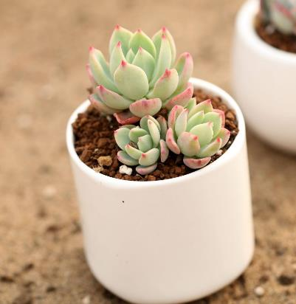
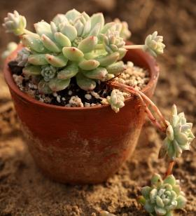
WRITE SOMETHING
ABOUT YOUR
COMPANY
A cactus (plural: cacti or cactuses) is any member of the spine plant family Cactaceae, native to the Americas. They are often used as ornamental plants, but some are also crop plants.

Slide 11
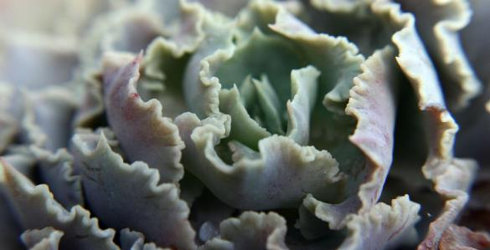
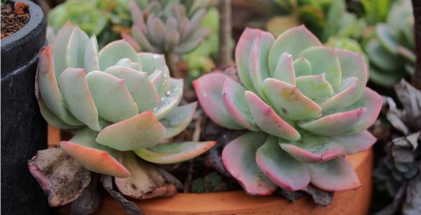
WRITE SOMETHING
Most designers set their type arbitrarily, either by pulling values out of the sky or by adhering to a baseline grid. The former case isn’t worth discussing here, but the latter requires a closer look.
WRITE SOMETHING
Most designers set their type arbitrarily, either by pulling values out of the sky or by adhering to a baseline grid. The former case isn’t worth discussing here, but the latter requires a closer look.

Slide 12
PUT YOUR TITLE HERE
Most designers set their type arbitrarily, either by pulling Values out of the sky or by adhering to a baseline grid. The former case isn’t worth discussing here, but the latter requires a closer look. Most designers set their type arbitrarily, either by pulling Values out of the sky or by adhering to a baseline grid. The former case isn’t worth discussing here, but the latter requires a closer look.

Slide 13
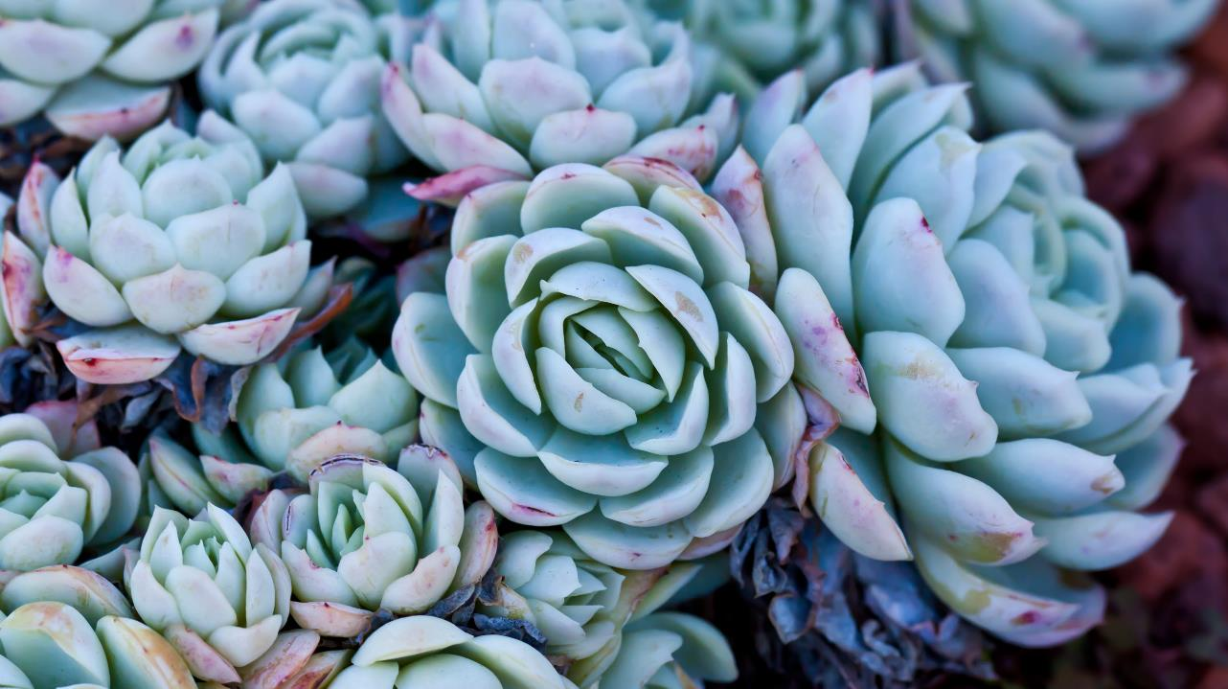
THANK YOU
Plants are very important living things. Life could not go on if there were no plants.

Slide 14
10000+套精品PPT模板全部免费下载
PPT营
www.pptying.com
Notes:
模板来自于 https://www.pptying.com 【PPT营】

